Slide 1

In conversation with our line managers

Slide 2
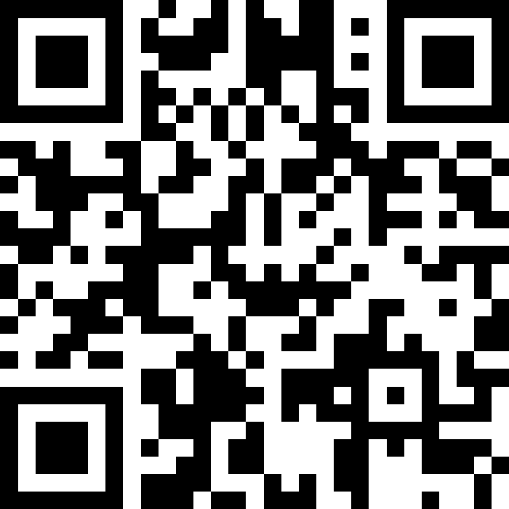
Slido
3487911
slido.com

Slide 3
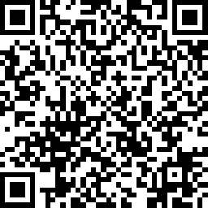
Your feedback
https://www.surveymonkey.com/r/midlandmet
Thank you to those you have taken time to feedback on how they felt the move was and how they have been settling into Midland Met
The survey is still open for you to continue to share your thoughts, and please encourage your teams to do the same
Some of the common feedback and what we are doing about it is summarised below:
Signage is an issue: We now have a working group who are focussing on how we can improve navigation around the site. We will be investing in more signage and making more use of volunteers and navigators to assist both staff and patients
Getting lost in the staff car park: We will be adding more signage and colour coding the staff car park to help you navigate it more easily. The best tip is to remember what lift core you enter the building via and exit using the same one
Issues with temperatures: Midland Met is an intelligent building – we don’t need to control the temperate by opening and closing the windows as we have done at Sandwell and City, or by using heaters and fans – in fact, these are counter productive. Temperatures in rooms and bays can be controlled by the thermostat on the wall. This week, we will be issuing a video from Warren and Kevin in Estates, explaining more about the building and how it works.

Slide 4


Phase two and three
Maternity, Neonates and Gynae
City Hospital

Slide 5
What happens on Maternity, Neonatal and Gynae Patient Move Day
Clinical teams start early at MMUH ready for first emergency patients
Early ward rounds on legacy site – focus on patients who can be safely discharged & final check on condition of patients transferring to MMUH
05.30: Final patient transfer census meeting
07.00: Delivery Suite cut over
06.30: Short briefing session for all colleagues undertaking patient move related roles
07.00: First patient transfer from NNU at 7.00am.
Remaining patient transfers in line with schedule
Equipment transfers continue

Slide 6
Maternity, NNU & Gynaecology
Patient Move Day - move order

Slide 7
What happens on City Patient Move Day
05.00: ED cut over
Early ward rounds on legacy site – focus on patients who can be safely discharged & final check on condition of patients transferring to MMUH
05.30: Final patient transfer census meeting
06.15: Short briefing session for all colleagues undertaking patient move related roles
07.00: First patient transfer from D12 Haematology
Remaining patient transfers in line with schedule
Equipment transfers continue
Supporting arrangements:
Additional EMRT at MMUH, no visitors apart from agreed exceptions, Critical care team, WMAS, ACCOTS, blood bank, Imaging, Theatre team remain at legacy site until last patient has left.

Slide 8
City Patient Move Day - move order
Track 1 (Adults)
–
0700 Start
Track 2 (ITU)
–
0830 Start
1. D12
–
Haematology
1. Critical Care
2. D5
Finish 13.00
–
Cardiology
Assumes
12 patients transfer in this track &
1pt leaves every 30 mins
3. D7
–
Cardiology
4. D15
–
Respiratory
5. D17
–
Respiratory
6
. AMU1
7
. City A&E Admission Placeholder
8
. AMU2 & Toxicology
9
. D11
–
Medical
1
0
. D27
–
Medical
1
1
. D26
–
Medical
Finish 14.16
Assumes
219 patients transfer in this track &
1pt leaves every 2 mins
1
2
. AMU
Contingency (Hard Line for
Discharge/Transfer) for 7 pts
–
finish 14.30

Slide 9
Key Equipment Move Lessons Learnt
Insufficient volume of equipment transferred in early phases.
Poor cleaning of some transferred equipment – drip stands
Labelling of equipment with insufficient detail i.e. no destination room address
Request to transfer non-critical equipment on move day i.e. office furniture, visitor stacking chairs, general stock items and even Christmas decorations
Some critical items not transferred on move day - Infusion pumps. NIBP monitors
IT wows will transfer to IT workshop in first instance
Do not move broken beds/equipment
Notes:
We will open MMUH in 2024.
It is happening!
We need to now focus on the purpose
Personal reflections re annual plan delivery – delivering success……..needs to be good enough (not perfect) to male a decision to safely move on time.
Our vision – related to measuring success of our strategic benefits ( financial and non financial)
We must always practice out values – we will have tough times ahead – but please find time to practice our values of ambition, respect and compassion.
We will be looking a little later on our impact so far to contributing to the successful delivery of the programme objectives …….but first lets take a look back at our successes…..paly video

Slide 10





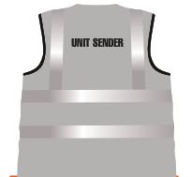
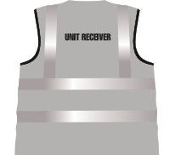


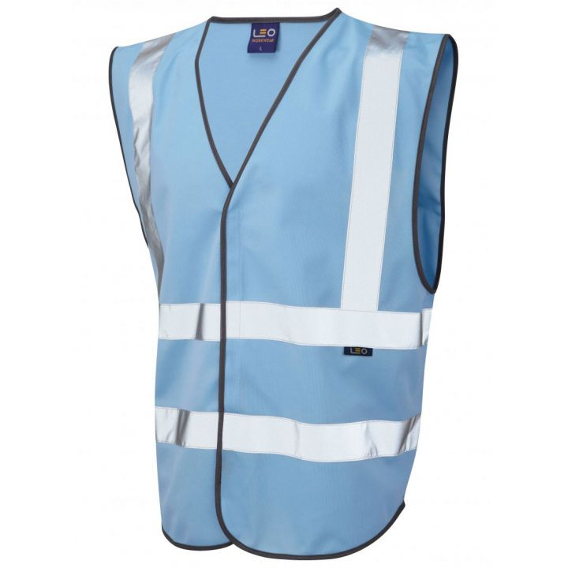
Move day roles
Global Sender
Global Receiver
Nurse Escort
Dedicated EMRT
Registration
Unit Sender
Unit Receiver
Transport
Clean Team
Move Control Team
Each of these roles has clearly defined responsibilities, which have been designed by HCR to help a move go as smoothly as possible
Notes:
We will open MMUH in 2024.
It is happening!
We need to now focus on the purpose
Personal reflections re annual plan delivery – delivering success……..needs to be good enough (not perfect) to male a decision to safely move on time.
Our vision – related to measuring success of our strategic benefits ( financial and non financial)
We must always practice out values – we will have tough times ahead – but please find time to practice our values of ambition, respect and compassion.
We will be looking a little later on our impact so far to contributing to the successful delivery of the programme objectives …….but first lets take a look back at our successes…..paly video

Slide 11
Move day roles
Both City and Midland Met will be extremely busy on move day.
Unlike the Sandwell move, MMUH is a working hospital, with a busy ED, inpatients and patients attending appointments, alongside visitors attending to see their loved ones.
The Sandwell move worked smoothly, because people stuck to their roles. There was a period where we had staff observing, which did slow the move down and creates a busy and noisy environment and not the patient experience we would like to provide.
If you are not involved in the move, or working clinically, please do not attend site – and if you are on site, please keep well away from the patient move route where possible.
HCR will ask people to leave if they do not have a role – this is the case of both sites.
Notes:
We will open MMUH in 2024.
It is happening!
We need to now focus on the purpose
Personal reflections re annual plan delivery – delivering success……..needs to be good enough (not perfect) to male a decision to safely move on time.
Our vision – related to measuring success of our strategic benefits ( financial and non financial)
We must always practice out values – we will have tough times ahead – but please find time to practice our values of ambition, respect and compassion.
We will be looking a little later on our impact so far to contributing to the successful delivery of the programme objectives …….but first lets take a look back at our successes…..paly video

Slide 12

Patient and Carer Move Leaflet
We have developed patient and friends/family leaflets, which contains important information about what they can expect on move day
These leaflets will be delivered to wards from Wednesday next week. There are separate leaflets for Maternity and Neonatal, which will be delivered this week.
Please hand them out and encourage your teams to have a conversation with patients about the move.
Some key things to discuss are:
Taking any valuables home – patients will only be able to take a small bag on the ambulance with them – so please encourage them to send personal belongings, especially valuables, home with friends or family
No visiting on move day – there will no visiting at City Hospital on 10 November unless children, vulnerable or end of life. Visiting will be open at Midland Met from 4.30pm on Sunday 10 November. Visiting times for wards already at Midland Met remains the same as normal.
Notes:
We will open MMUH in 2024.
It is happening!
We need to now focus on the purpose
Personal reflections re annual plan delivery – delivering success……..needs to be good enough (not perfect) to male a decision to safely move on time.
Our vision – related to measuring success of our strategic benefits ( financial and non financial)
We must always practice out values – we will have tough times ahead – but please find time to practice our values of ambition, respect and compassion.
We will be looking a little later on our impact so far to contributing to the successful delivery of the programme objectives …….but first lets take a look back at our successes…..paly video

Slide 13
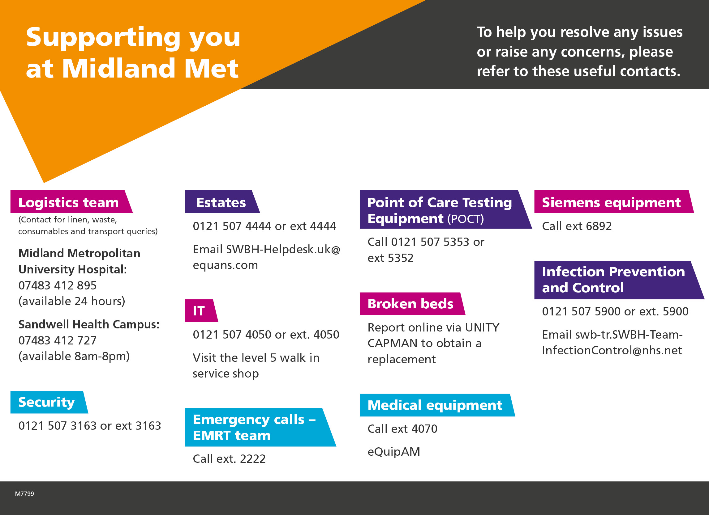
There were lots of issues raised about who to contact for what and how to contact them
This graphic aims to help you with that
Please share it with your staff – a printed one has also been distributed to wards and departments
It is also worth sharing with teams who are yet to move, to help familiarise themselves with MMUH
If you need more copies, please email swbh.comms@nhs.net
Notes:
We will open MMUH in 2024.
It is happening!
We need to now focus on the purpose
Personal reflections re annual plan delivery – delivering success……..needs to be good enough (not perfect) to male a decision to safely move on time.
Our vision – related to measuring success of our strategic benefits ( financial and non financial)
We must always practice out values – we will have tough times ahead – but please find time to practice our values of ambition, respect and compassion.
We will be looking a little later on our impact so far to contributing to the successful delivery of the programme objectives …….but first lets take a look back at our successes…..paly video

Slide 14
Let’s chat: Your opportunity
to ask questions

