Slide 1
In conversation with our line managers

Slide 2
Get Set for Midland Met
This is a phrase you are going to start hearing a lot more over the next few weeks
We have tried to combine the different ways in which we talk about Midland Met into one brand
We would encourage you to discuss with your teams what you need to do locally in order to ‘Get Set for Midland Met’ – could it be a standing agenda item in your team meetings?
What is part of Get Set for Midland Met?
Two communications bulletins a week – Monday and Thursday
Bi-weekly Operational Readiness conversations with our Directorate and Group leaders – please do try your best to attend
Fortnightly Get Set for Midland Met – conversation with line managers
Walkabouts – execs and senior leaders will be visiting departments to talk to staff about the move
Temperature check – a very short survey to determine any gaps in knowledge at MMUH
Your questions answered - an opportunity for you to ask any questions or tell us what more you need
Quizzes – what do you know about MMUH? Prizes will be on offer!
Badges – everyone loves a badge!

Slide 4
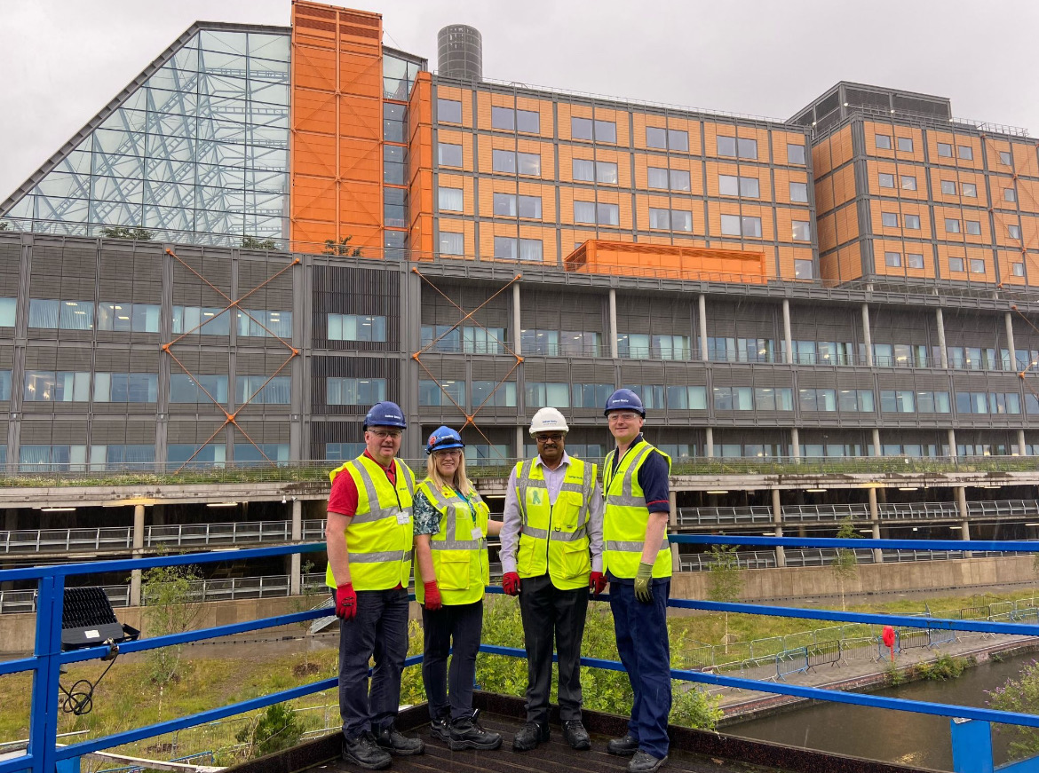
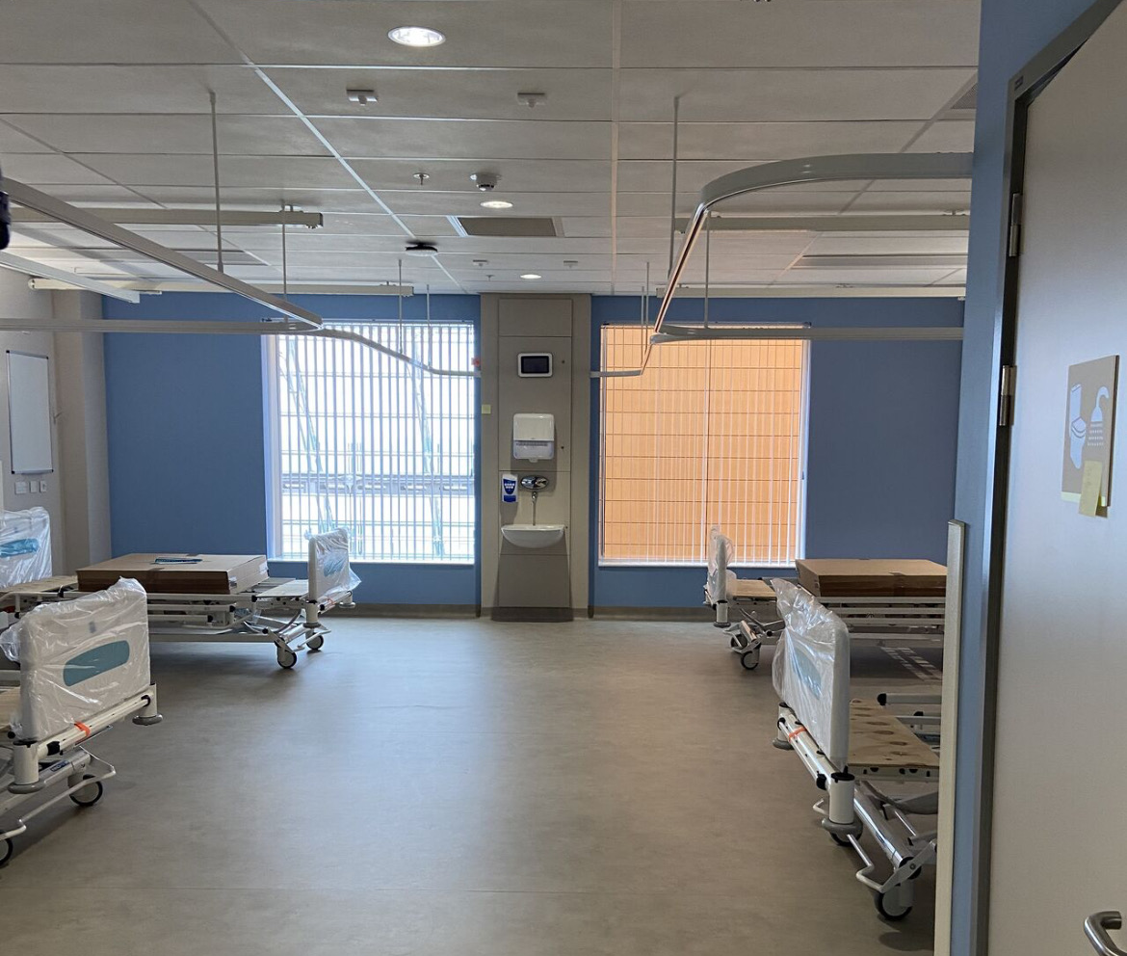
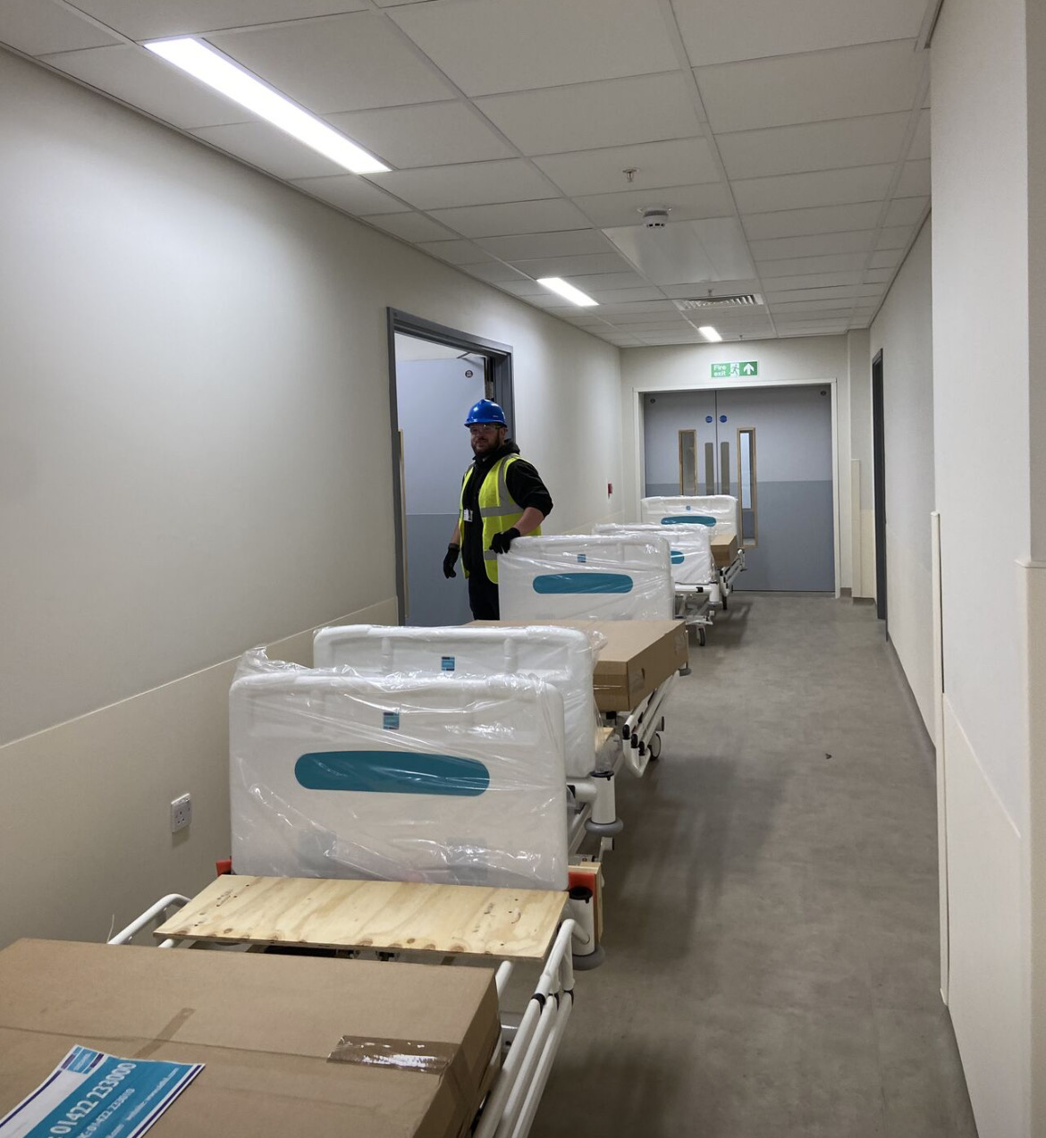
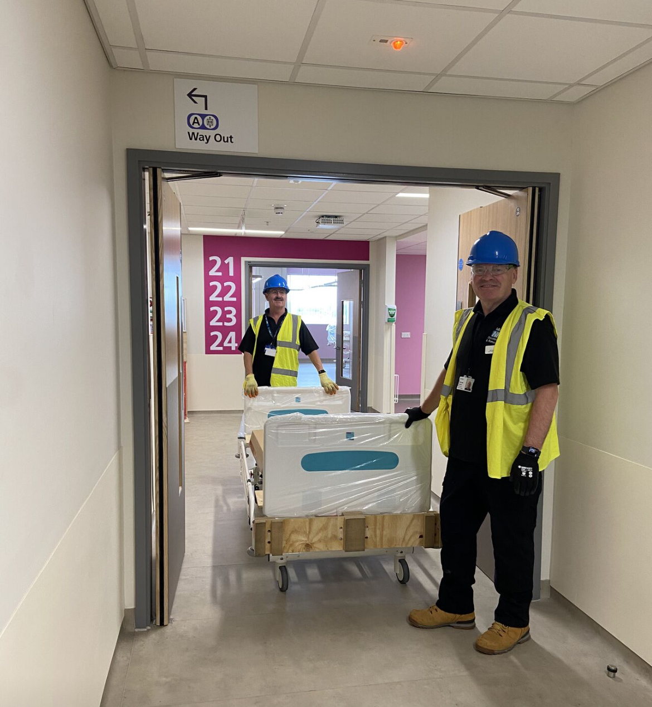
IPC checks completed
The beds are in

Slide 5
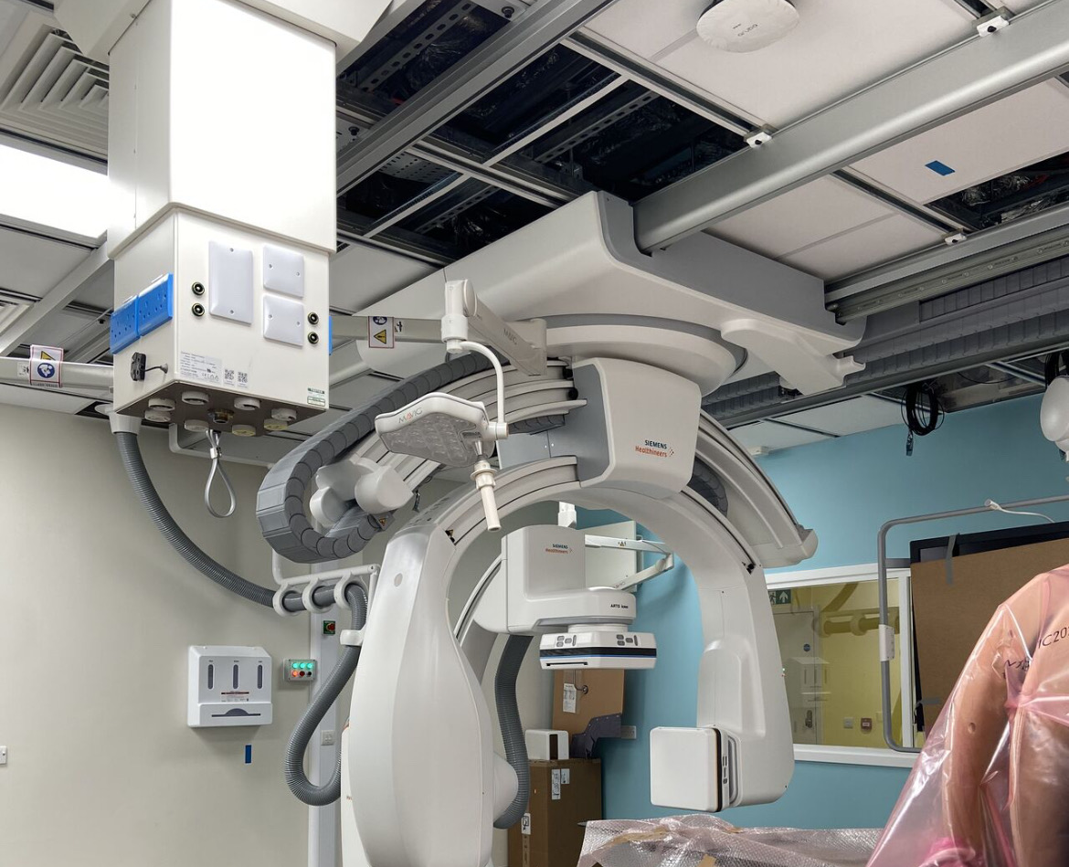
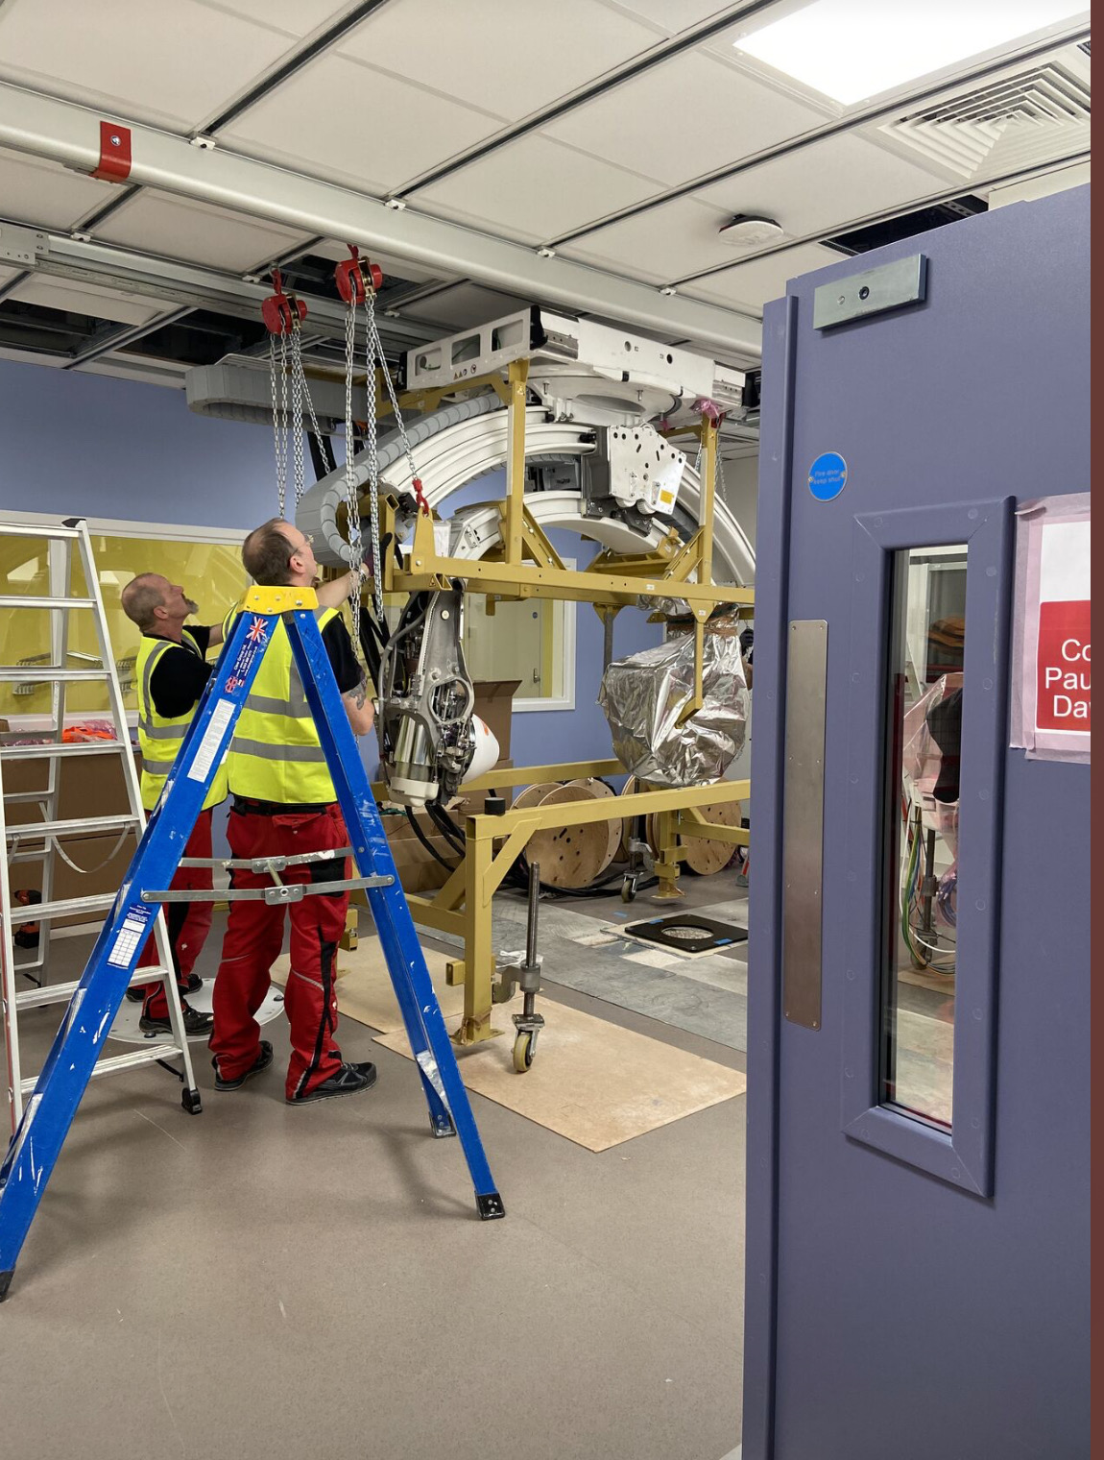
Second cath lab being installed

Slide 6
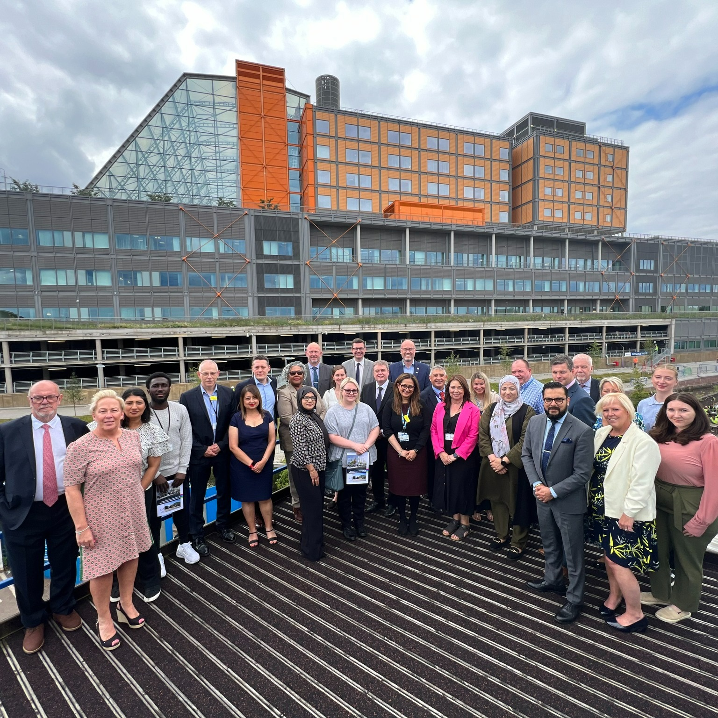
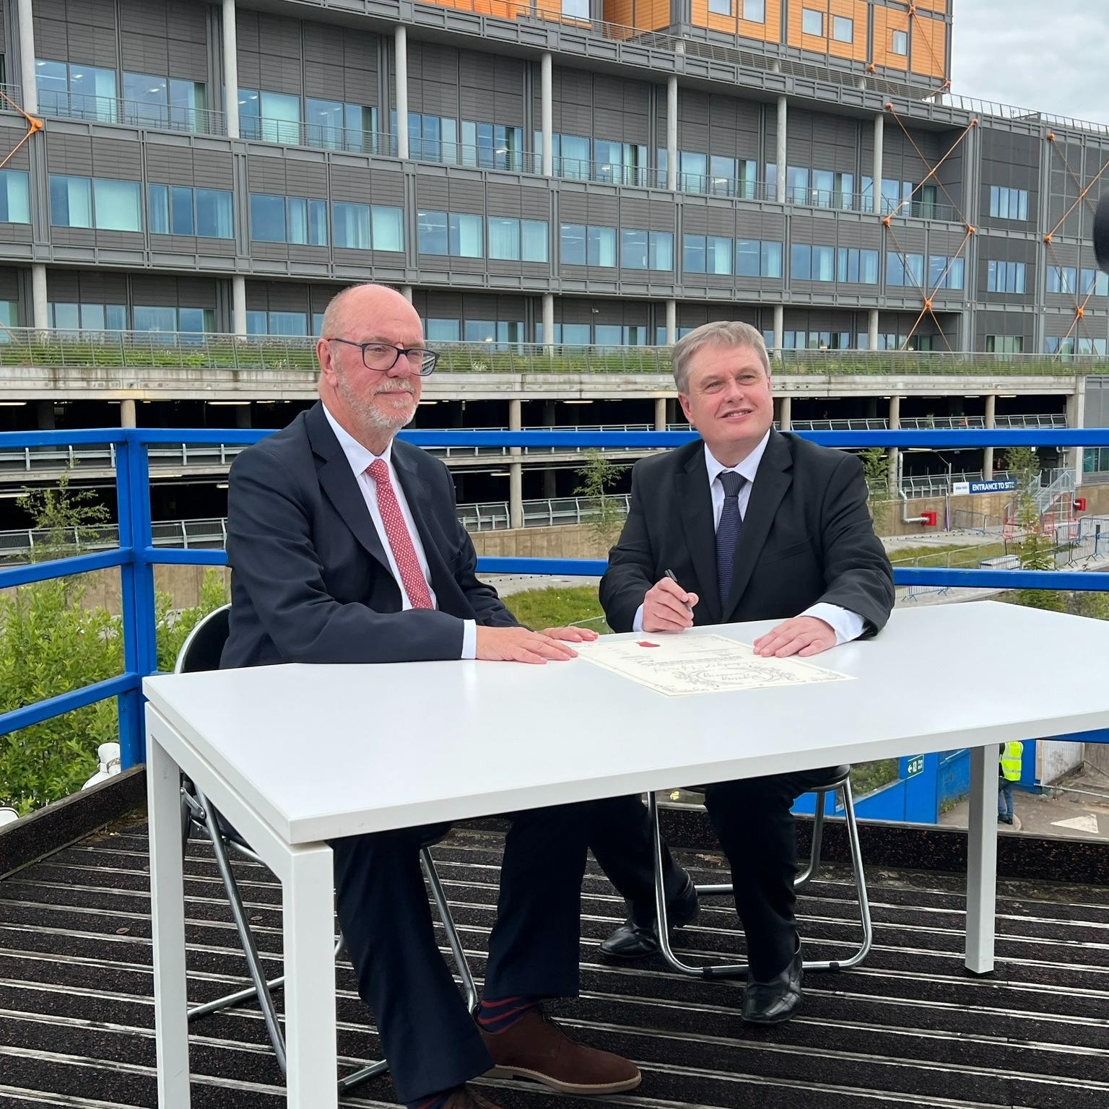
Learning Campus agreement signed with Sandwell Council

Slide 7
Operational Readiness: Where are we at?
At the end of June, our operational readiness was 46.6%, against a target of 49.9%
There are some key things that must be delivered before the end of July:
Continue to finalise job plans and consultant rotas for Midland Met and upload them onto eJob Plan
Continue to work with IT to validate devices – this is to ensure that the equipment you are issued with, based on what you have in your current location is correct. If you need any assistance, please contact Imran Ravat i.ravat@nhs.net or Zurvad Hussain zurvad.hussain@nhs.net
Unity ward build confirmations to be sent to business change managers with any changes or updates
Check any patient leaflets that might need amending due to service changes – you need to speak to the library services about amends that need to be made

Slide 8
Induction tours: Why did we pause?
We are now on the final run in to achieve planned completion and building handover.
With our own soft activation activities and the ongoing technical commissioning, the site was getting incredibly busy.
This hampered Balfour Beatty’s ability to be able to carry out essential testing, which needs to be completed before they hand over the building to us.
By extending the pause on our induction tours until 5 August, Balfour have been able to continue their momentum – so thank you for your patience and understanding around this.
Please do not try to re-book at the moment, as all the remaining tours are currently full. The induction team will be putting on sufficient capacity to recover lost tours and we will communicate when these can be booked as soon as possible.
Teams who are due to move first will be prioritised.
If you have any questions or concerns, please e-mail swbh.mmuhinduction@nhs.net

Slide 9
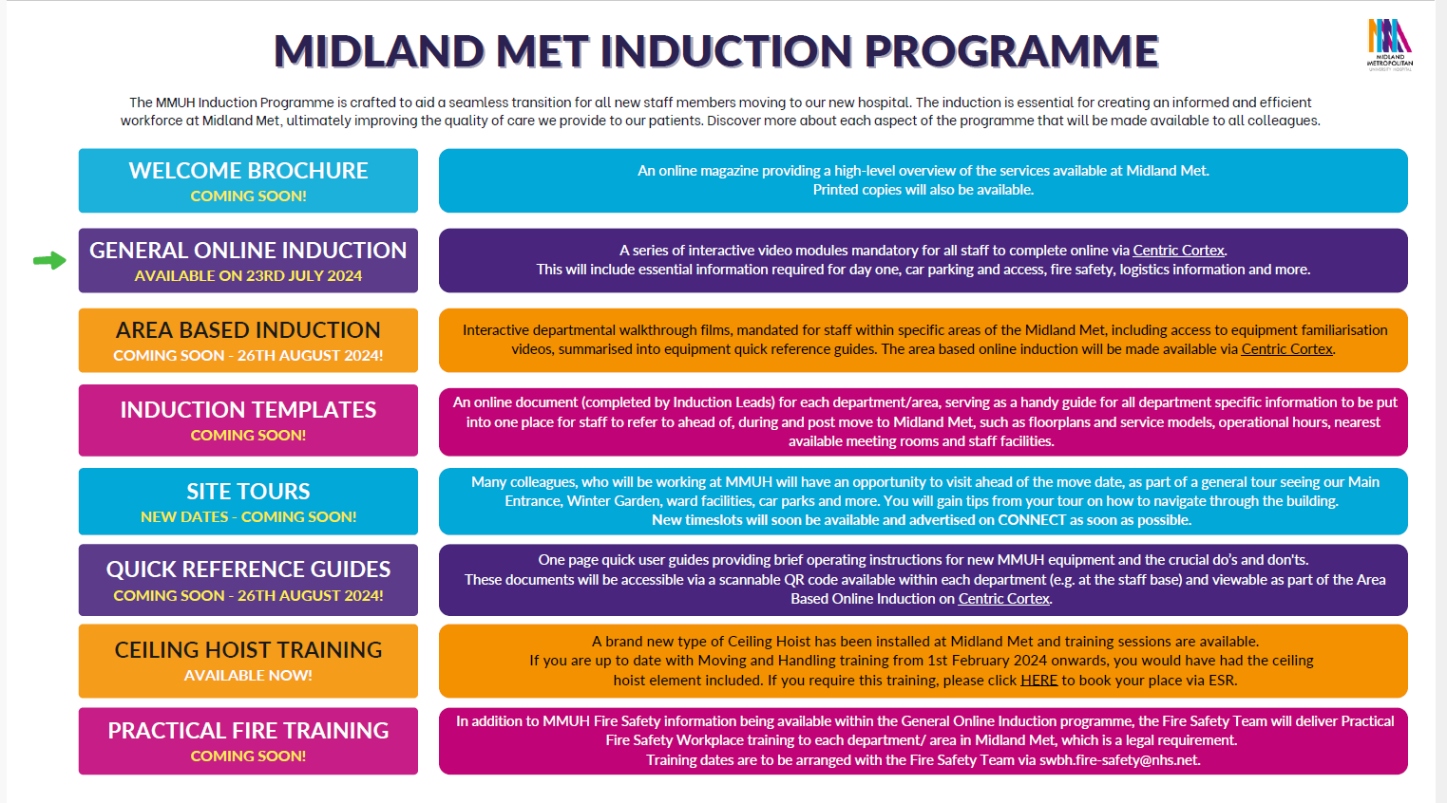

Slide 10
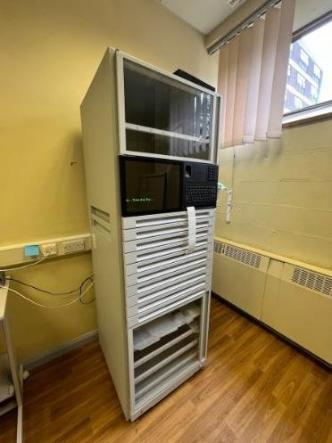
Omnicell: Our new medicine management system
We’re pleased to introduce Omnicell to help us modernise our medicine management processes.
We have invested in new Omnicell Automatic Dispensing Cabinets (ADCs) and smart carts (new technology) to help improve our medication administration system.
ADCs and smart carts are being introduced to all high medication usage areas across Sandwell and City. They will also be used at Midland Met, so we are getting colleagues ready to use the new ADCs and smart carts now ahead of moving to Midland Met.
The first smart carts and cabinets have arrived at Sandwell and are currently being set up.

Slide 11
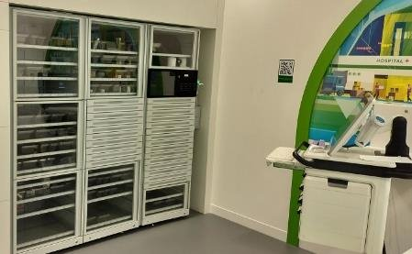
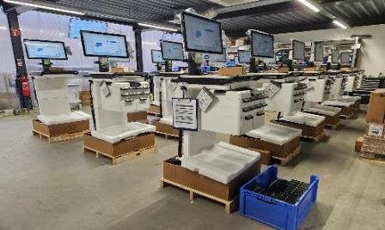
Super user training
Omnicell super user training begins tomorrow - Tuesday, 23 July, in Sandwell.
Following the completion of this phase, end-user training will start for the rest of our colleagues who will be using Omnicell, led by our super users.
City super user training will follow on from 12 August. Super users will again take the lead in training all end users across departments.
We are completing comprehensive training to ensure everyone knows how to use this new technology. It is essential that all colleagues who will be using Omnicell complete their training, both super users and end users.

Slide 12
Omnicell resources
Please familiarise yourself with the super user training schedule
Training guide
Discover how Omnicell works by watching this short video →

Slide 13
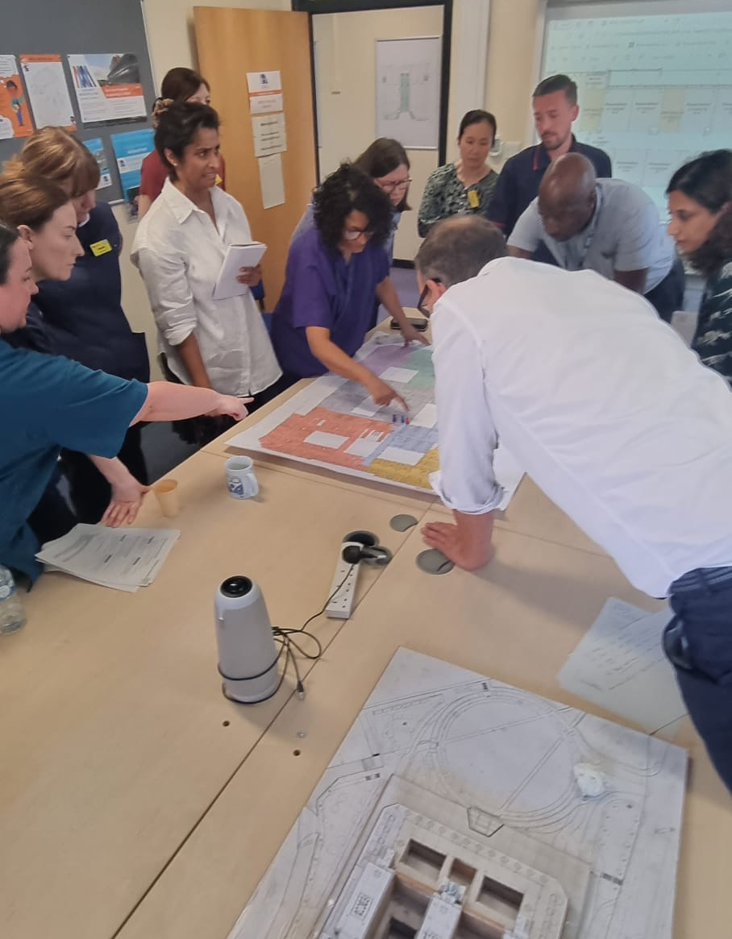
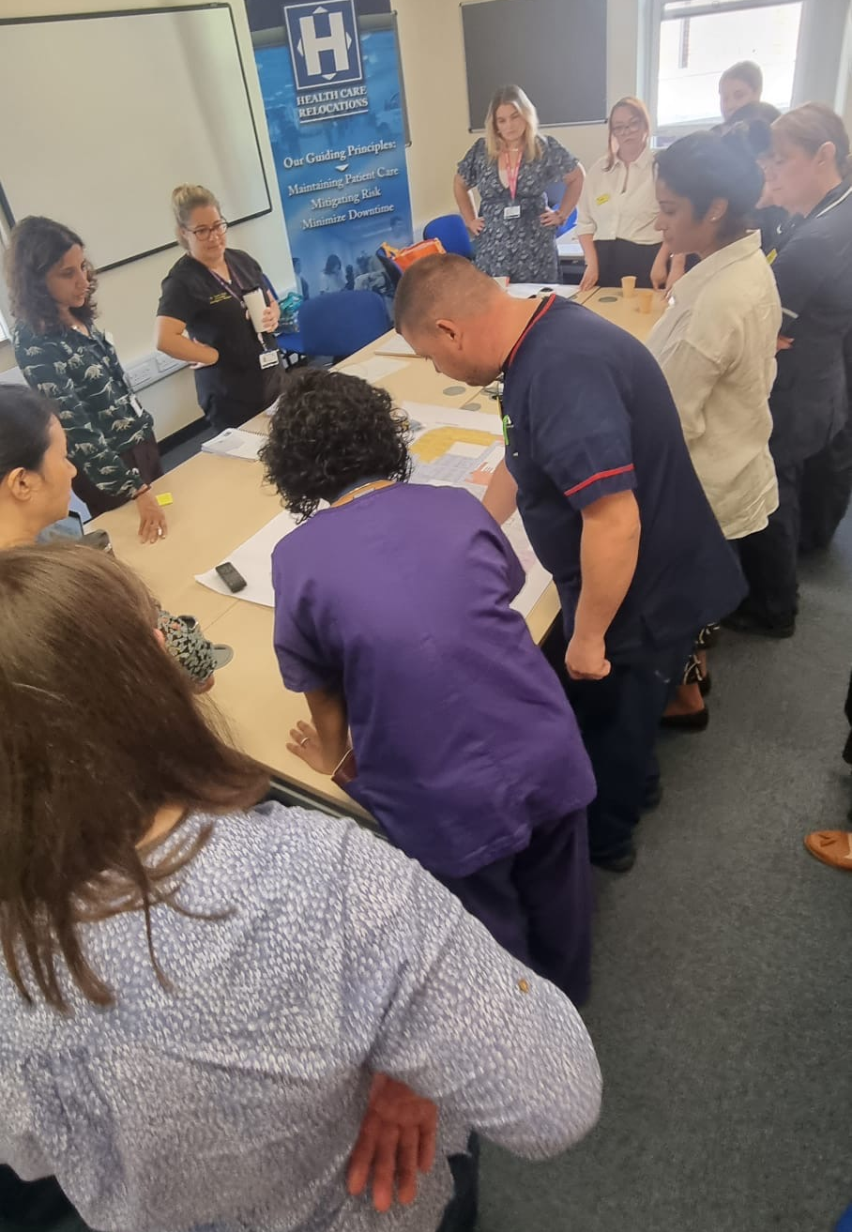
Testing our critical patient flows
We have now commenced testing the critical patient flows that have been developed over the last two months with the MMUH safety group.
Collaborating with specialty teams has been important to gain clarity and confirmation of the changes and procedural steps and to mitigate potential issues, risks, or hazards within these critical patient flows, including other key dependencies and interdependencies such as: policies, clinical guidelines, NICE, SOPs, IT, and necessary job planning/training.
Three sessions have already taken place, with excellent engagement and discussions – thank you to everyone who has taken part.
The sessions are vital components of the MMUH safety case, demonstrating that our transition to MMUH is proceeding safely and effectively.

Slide 15
Dates for your diary
23 July – Omnicell super user training starts
24 July - Clinical and Operational Readiness Away Day
25 July – Group reviews – Stock take on Operational Readiness
1 August – Get Set for Midland Met walkabouts begin
5 August – Omnicell carts arrive at City Hospital
6 August – Omnicell roll out starts on Sandwell wards
21 August – Go/No Go Decision at Board
22 August – Patient and Population comms go live (board decision dependent)
28 August – Omnicell roll starts on City wards

Slide 16
Let’s chat: Your opportunity
to ask questions

