Slide 1


SEPTEMBER 2021
Midland Metropolitan University Hospital
Lunch and Learn – May 2023

Slide 2
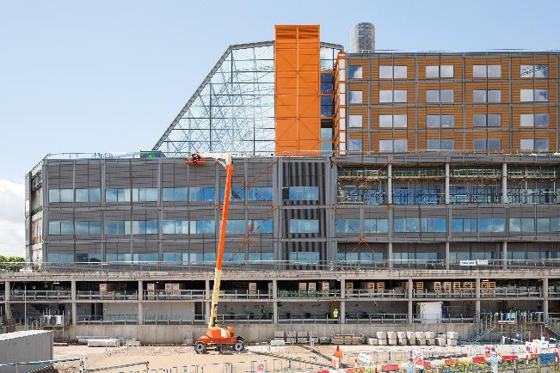
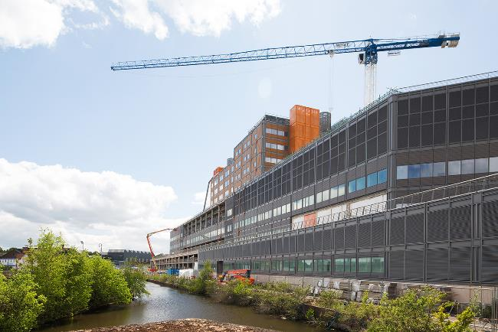
Agenda
Item
1. Hello, my name is and housekeeping
2. Our journey and getting to know Midland Met
3. Our future service model
4. Regeneration, fundraising and our learning campus
5. Q&A
6. Next steps
7. Close

Slide 3
Hello my name is...
Rachel Barlow – Managing Director of the Midland Met Programme Company
Jayne Dunn – Director of Commissioning and Equipping
Dr Sarbjit Clare – Deputy Chief Medical Officer
Ruth Wilkin – Director of Communications

Slide 4
SEPTEMBER 2021
Our journey and getting to know Midland Met

Slide 5
Our journey so far
Timeline | Activity
2007 | Formal consultation of closures of A&E at City and Sandwell Hospitals concludes
2011 | Site purchased in 2011
2015 | Carillion selected as preferred construction company
2016 | Building started
2018 | Carillion went into liquidation causing delays
2019 | Balfour Beatty selected to complete the project
2020 | Pandemic hit, however building work continued throughout this period
2024 | Midland Metropolitan University Hospital scheduled to open

Slide 6
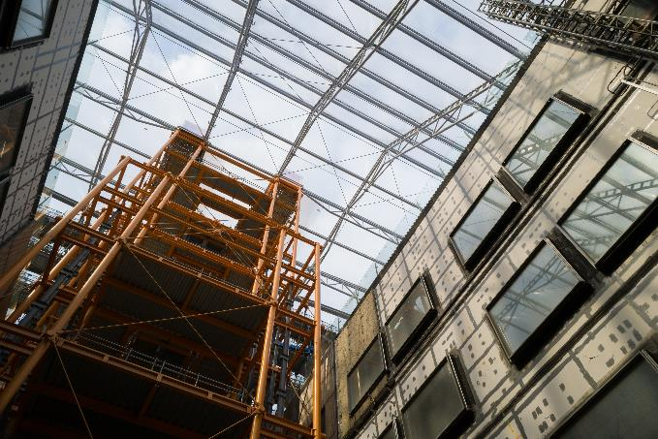
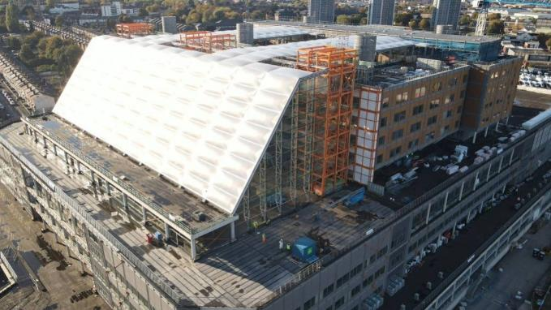
Getting to know Midland Met
Midland Metropolitan University Hospital will be our acute centre for care and includes:
A purpose-built emergency department with co-located imaging and diagnostic services.
A dedicated children’s emergency department and assessment unit.
Operating theatres for both emergency and major planned surgery.
A midwife led birth unit next to a delivery suite, two maternity wards
and an antenatal clinic, plus a neonatal unit.
Same day emergency care for adults.
Sickle cell and thalassemia centre.
Patients can expect to receive all of this as a standard part of our care model:
The same high standards any day of the week with senior doctors leading expert clinical teams.
Diagnostic tests including x-ray, MRI and CT scans, plus other tests for urgent care.
Our Winter Garden and outdoor spaces are designed to help patients stay active.

Slide 7
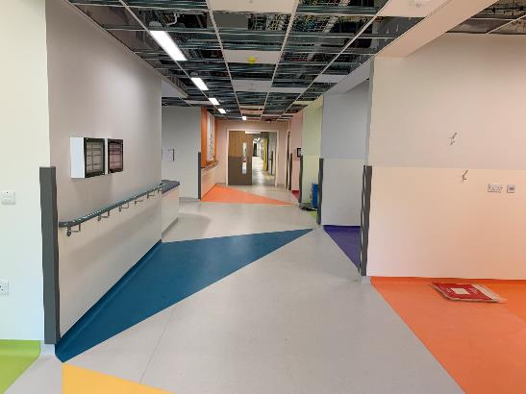
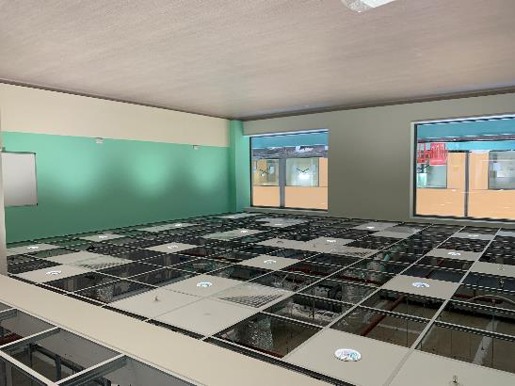
The benefits of our new hospital
The hospital will house state-of-the-art equipment to support faster diagnosis and improve patient outcomes.
It will be home to 11 emergency, trauma and elective inpatient operating theatres, maternity theatres and 15 birthing rooms for maternity services.
The wards and rooms centre on patient wellbeing. All bedrooms have an external view onto one of the courtyards or surrounding areas of the hospital.
The design includes 50 per cent single rooms with en-suite shower rooms in the main ward areas which will reduce the risk of spreading infections.
The hospital provides a dementia friendly environment. Colours and clear bed numbers will help patients identify where they are. Layouts of wards will be the same, with each group of four beds within a ward having a different colour theme.

Slide 8
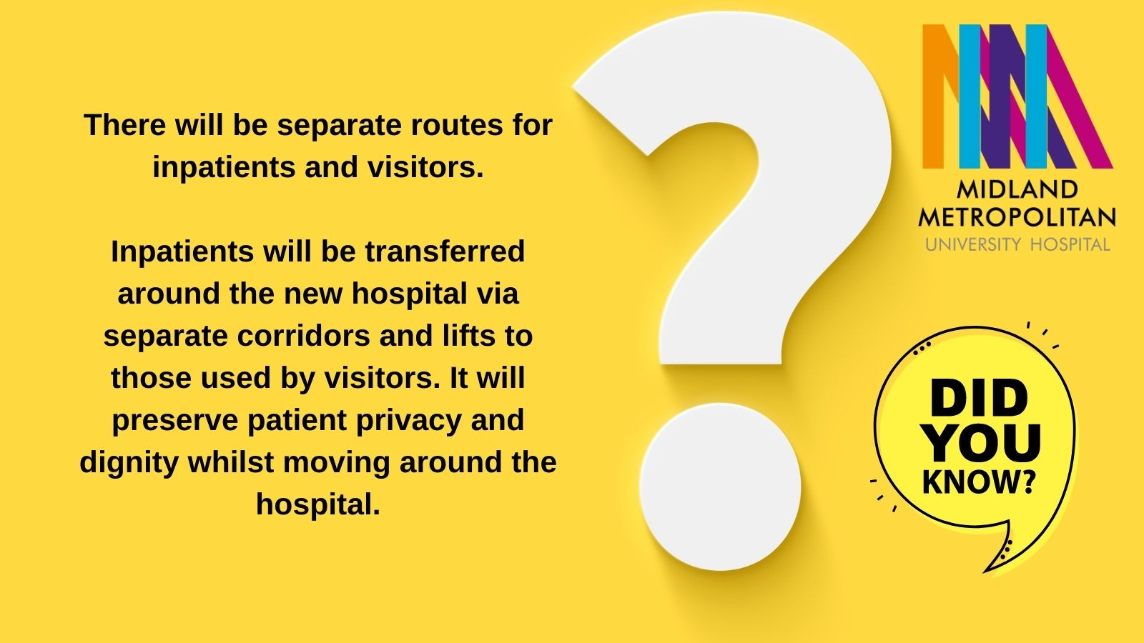

Slide 9
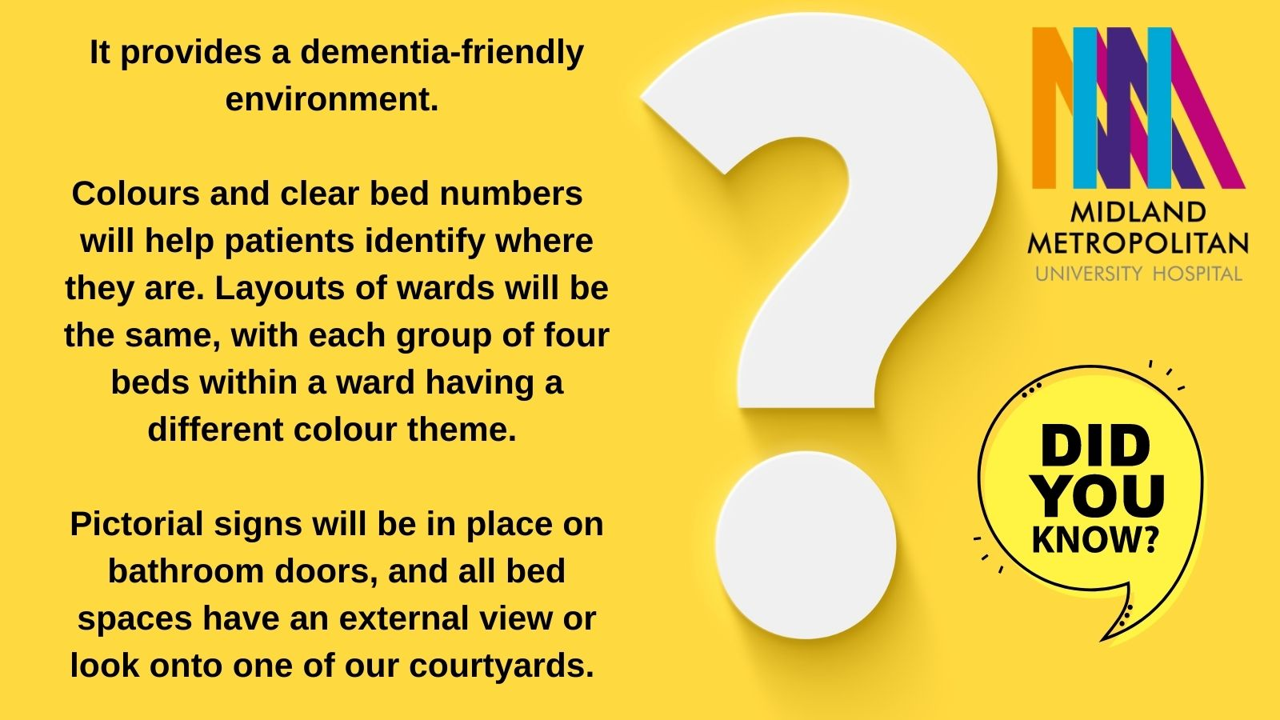

Slide 10
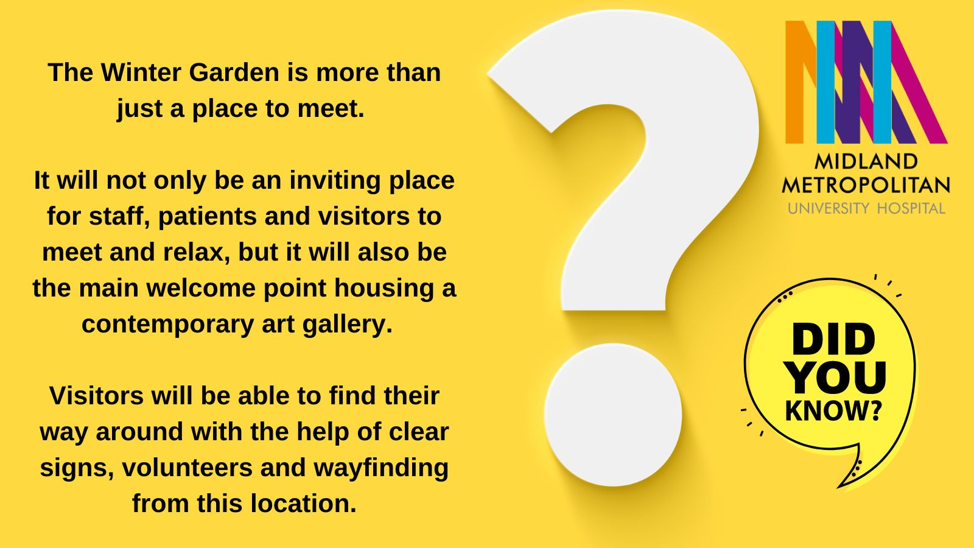

Slide 11
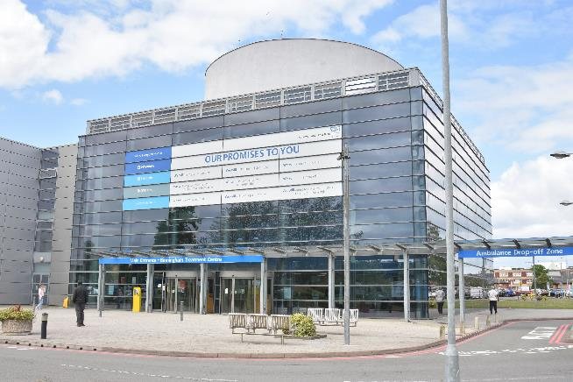
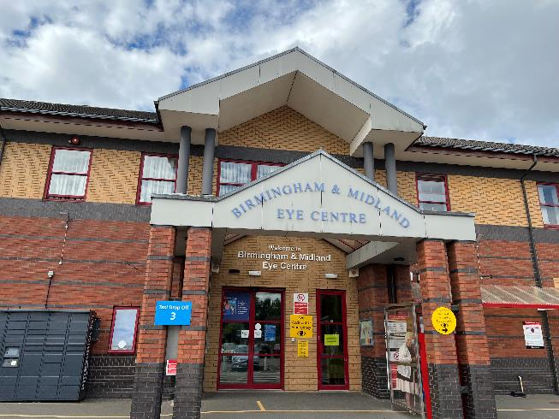
Our future service model
Whilst Midland Met will care for patients that need emergency care or a stay in hospital, most outpatient care, day-case surgery and routine diagnostics remain at the Sandwell and City Hospital sites. This includes
  A 24/7 urgent treatment centre in Sandwell.
  Birmingham Treatment Centre and Birmingham and Midland Eye Centre (BMEC) at City Hospital.
  Provision for step down / rehab facilities.
Significant changes are taking place in our community and primary care services so that even more care can be provided in people’s own homes.

Slide 12
Clinical services transformation
In preparation for the opening of Midland Met, crucial work is being undertaken across 12 areas to transform our services, focusing on our acute care model. It comprises of these services.
Emergency Department
2 site to 1
  Senior decision making supported by rapid diagnostics to support right care right place.
Acute therapies
2 sites to 3
  Extended working hours will enable patient therapy provision to support earlier discharge.
Same Day Emergency Care
2 site to 1
  Expansion of same day emergency care (SDEC) pathways to optimise ambulatory care, reducing admissions and assessment unit demands.
Imaging
2 sites to 3
  Improved turnaround times will support rapid decision making at the front door. Demand management and artificial intelligence will improve efficiency.
Assessment Units
2 site to 1
  Rapid diagnostics and decision making over seven days to reduce length of stay (LOS) in assessment units.
Endoscopy
2 sites to 3
  Separation of inpatient and outpatient endoscopy to the treatment centres and Midland Metropolitan University Hospital to support patient flow and productivity.
Older peoples Care & Frailty
2 site to 1
  End to end acute and community care will prevent patients being admitted unnecessarily or reduce LOS if admitted.
Place Partnership
  Community beds and home-based services right sized to enable increased supported discharge from acute settings.
Stroke Decoupling
  Rehabilitation to be provided in a community setting to improve patient care, end of life experience and release acute beds.
Theatres
2 sites to 3
  Increased use of day case pathways with day case activity split from elective and emergency activity will improve.
Cardiology
  Increased use of ambulatory pathways and day case procedures will prevent patients being in hospital unnecessarily.
Enhanced Care
  Provision of a post anaesthetic care unit (PACU) and ward based enhanced care to support care pathways.

Slide 13
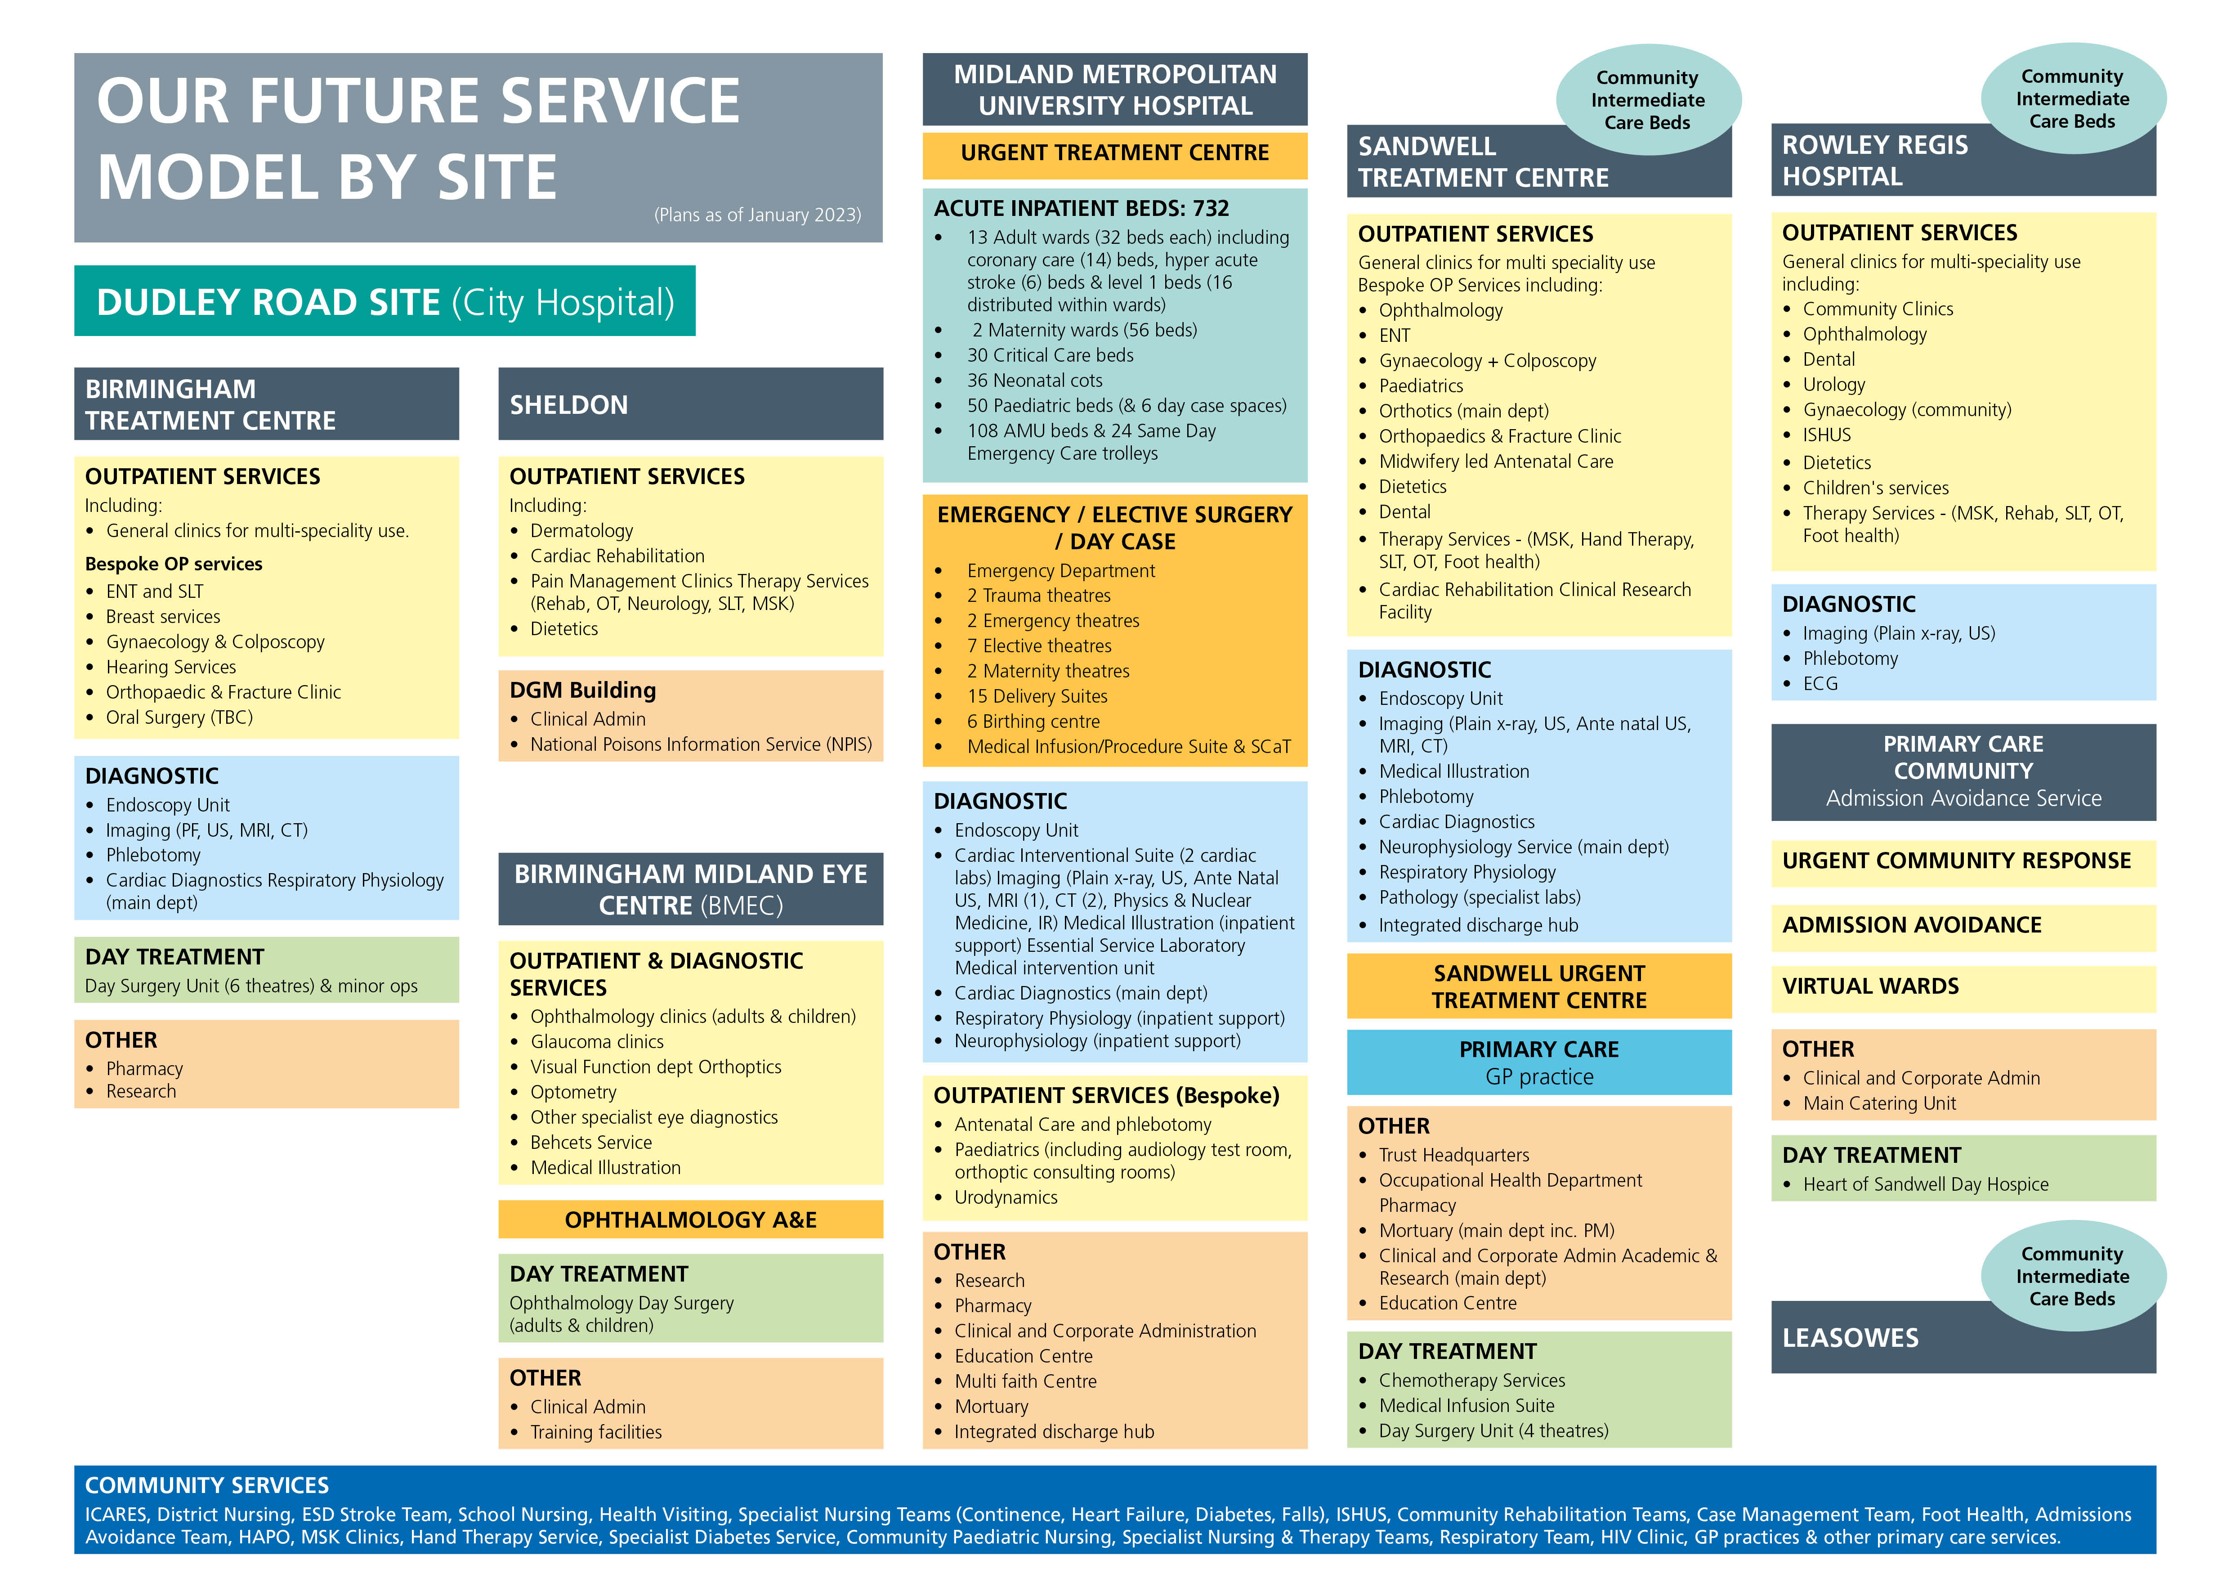

Slide 14
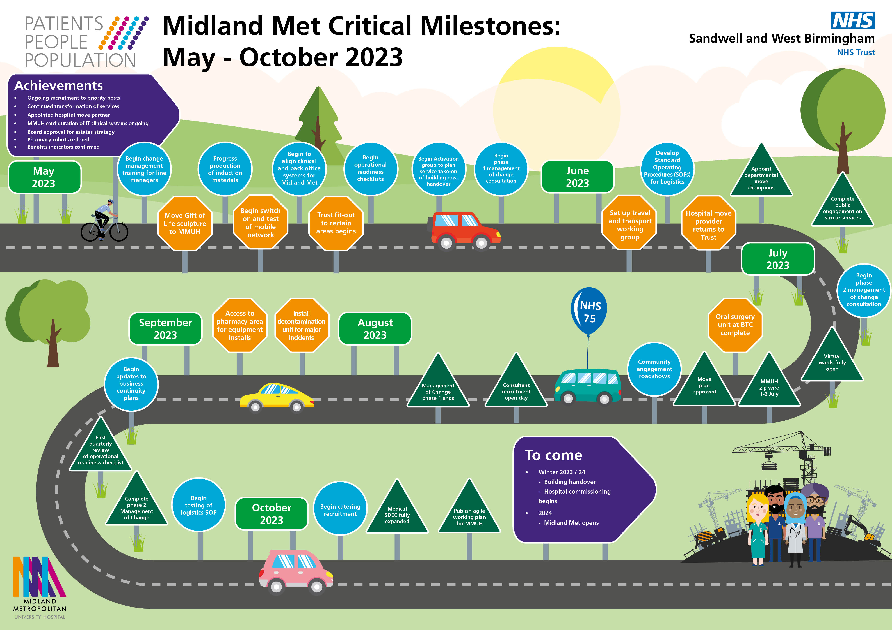
Notes:
A lot is going on behind the scenes at Midland Met as we get ready for its opening in 2024.
Our roadmap sets outs key milestones for the project for the next six months.

Slide 15
SEPTEMBER 2021
Regeneration, fundraising and learning campus

Slide 16
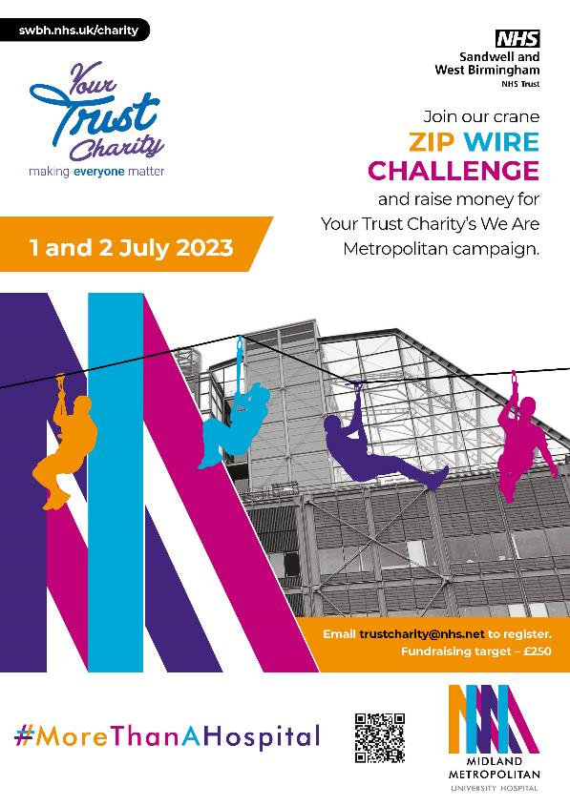
Supporting We Are Metropolitan
Your Trust Charity is the registered charity of Sandwell and West Birmingham NHS Trust and is passionate about making a difference in people’s lives.
Your Trust Charity is working hard to deliver our We Are Metropolitan fundraising campaign and raise £2m to:
  Develop community spaces.
  Create a welcoming and healing environment.
  Enhance research and development.
Your Trust Charity is helping our organisation play a major role in new community regeneration initiatives within our local communities.

Slide 17

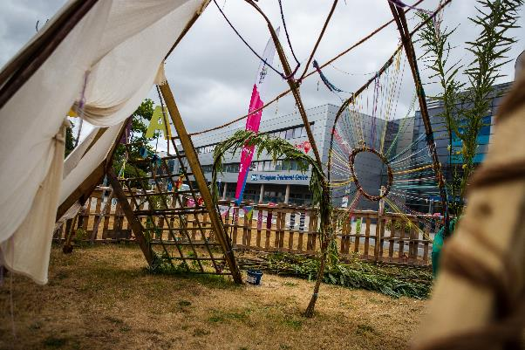
Our arts programme
The hospital has the most amazing gallery space, one of the longest in the region.
We are investing in high quality arts, education, and heritage programmes to help enhance the experience of our patients.
We’ll deliver an exciting arts and culture programme with lots of great cultural partners for our opening festival.
We have several programmes in development that imagines the hospital as a site for socially engaged art, a place for children beyond the classroom and a civic and community hub and garden.

Slide 18
Key elements of regeneration
​
Economic​
Increasing skills, employment and wages, attracting new businesses and investment, redevelopment of brownfield land​.
Encouraging new housing and infrastructure investment​.
Social and cultural ​
Interventions which promote health and wellbeing, strong and engaged communities, arts and culture​.
Environmental​
Sustainability and net zero carbon.
Active travel initiatives, accessible green space and measures to reduce air pollution​.
Effective delivery requires:​
Leadership and vision​.
Collaborative working and partnerships.
Aligning resources​.

Slide 19
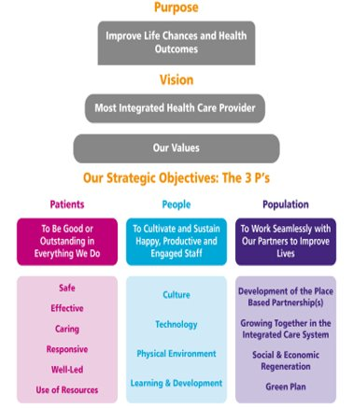
Why talk about it?
Emerging focus for the Trust​.
Trust purpose – Improving life chances and health outcomes.
Integrated care systems, levelling up agenda, and our position as the major anchor and largest employer in the immediate area​.
Midland Metropolitan University Hospital “More than a Hospital” and City Hospital site is one of the largest future development sites in Birmingham​.
Significant catalyst for major transformation and collective long-term investment driving transformation wider than just health.
Key partnerships - Two integrated care systems, Councils and Combined Authority.
We are using our position and resources to improve the health, wealth and wellbeing of our communities.

Slide 20
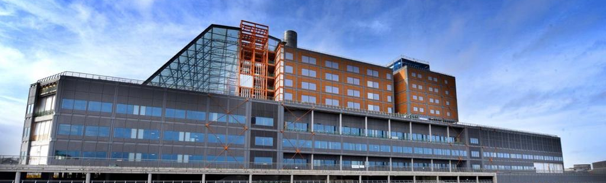
Partnership with the Sandwell College, Aston and Wolverhampton universities, incorporates The Learning Works​.
Focus on skill shortages across additional clinical services, allied health professionals and nursing and midwifery.
Provides pathways into long term employment for residents and will accelerate the delivery of transformational regeneration in the area​.
Midland Met learning campus

Slide 21
SEPTEMBER 2021
Over to you…Q&A

Slide 22
Keeping you informed
Are there any questions about MMUH and the associated programme?
How do you want to be kept informed about the hospital and its progress?
What topics would you be interested in at a future lunch and learn session?

Slide 23
Thank you
Future Lunch and Learn sessions
June: Management of Change
Discover what management of change is and the three phases involved as we prepare to move to Midland Met.
5 June 12 - 1pm Virtual Session: Click to join online here
7 June 12 - 1pm Face to face: Room 9 Education Centre, Sandwell Hospital
Future dates:
July
3 July 12 - 1pm Virtual
5 July 12 - 1pm: Rowley Regis Committee Room
August
2 Aug 12 - 1pm City Hayward Post Graduate Centre
7 Aug 12 - 1pm Virtual
September
4 Sept 12 - 1pm Virtual
6 Sept 12 - 1pm Sandwell Room 10, Education Centre
October
2 Oct 12 - 1pm Virtual
4 Oct 12 - 1pm Rowley Regis Committee Room
November
1 Nov 12 - 1pm Dining Room, Post Graduate Centre, City
6 Nov 12 - 1pm Virtual

