Slide 1

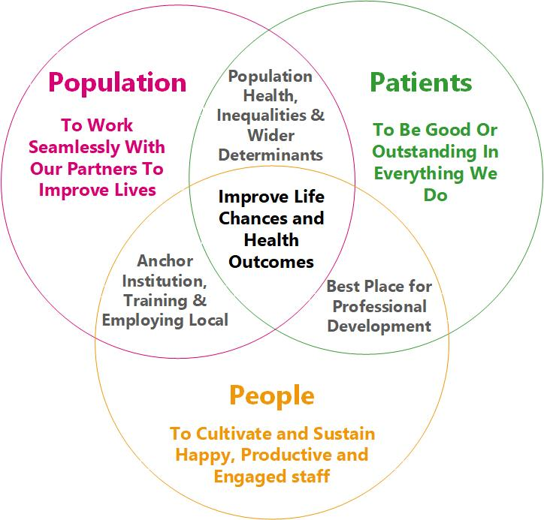
Welcome to SWB TeamTalk
April 2022

Slide 2

TeamTalk Agenda
April 2022
1.00pm: Our strategy
1.05pm: Latest updates – Patients
1.15pm: Latest updates – Population
1:25pm: Latest updates – People
1:40pm: Your questions answered

Slide 3

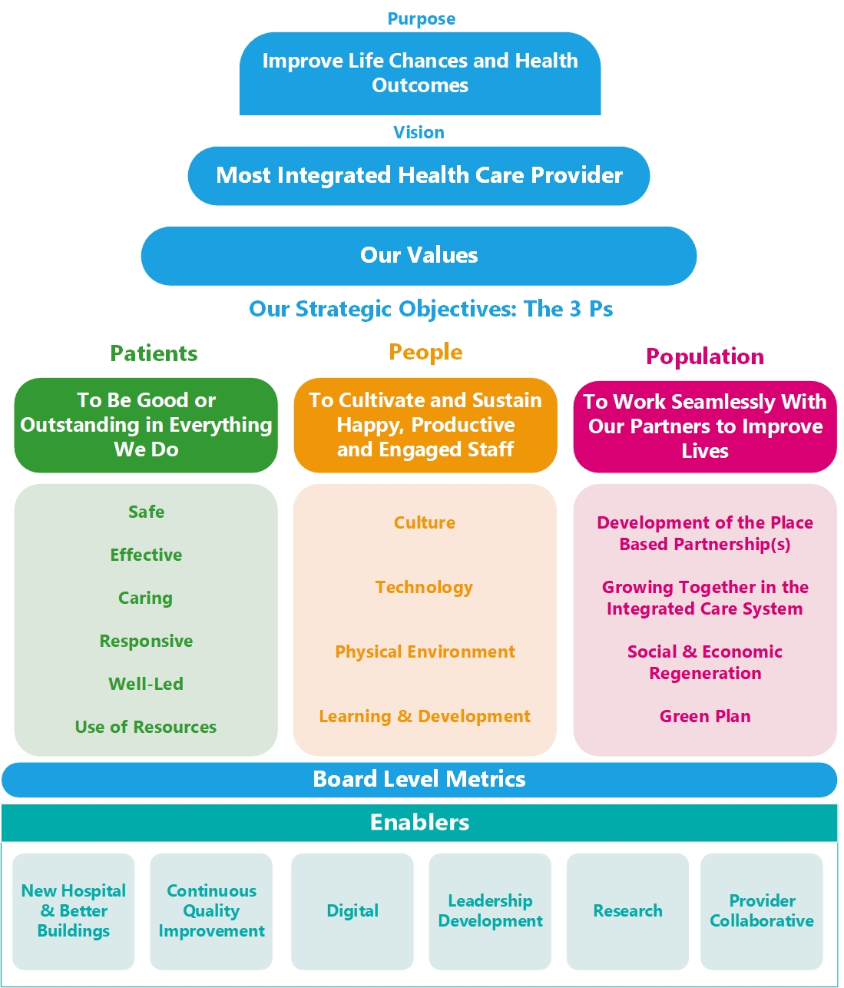
April 2022
Embedding our new strategy
The strategy was approved at Trust Board at the beginning of February – it sets out our purpose and vision.
Our three strategic objectives have been confirmed as:
  Patients - To be good or outstanding in everything we do
  Population - To work seamlessly with our partners to improve lives
  People - To cultivate and sustain happy, productive and engaged staff
We will be sharing more information about the strategy over the next few weeks with staff and external organisations, as well as share with patients and the public.
We will be asking you all to consider how you contribute to the three strategic objectives and asking all teams to identify this in their planning and objective setting for the year ahead.

Slide 4
Patients
To be good or outstanding in everything we do
April 2022

Slide 5

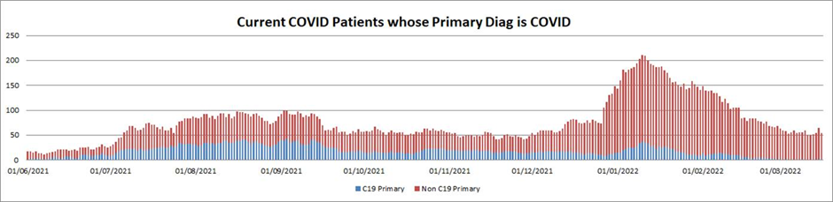
April 2022
COVID-19: Latest dashboard
This shows the trend of current inpatients and those marked with primary diagnosis as C19

Slide 6

April 2022
General visiting entry restrictions eased – LFT only required in maternity
General visiting restrictions have been eased to remove the need for visitors to inpatient areas to show evidence of a negative lateral flow.
All visits must be booked in advance by telephoning the ward to allow wards to limit the number of visitors on a ward/bay at any one time.
We will review visiting arrangements weekly based on a risk assessment taking into account COVID-19 case rates in the community and numbers of COVID-19 cases in our hospitals.
For more information see the visiting information here.

Slide 7
April 2022
Violence and aggression – zero tolerance
As visiting has eased we are seeing some isolated incidents of aggressive behaviour from visitors when asked to comply with our visiting restrictions
Cases of violence and aggression must be reported on our incident reporting system and flagged to your managers.
Please ask perpetrators to leave the site. Security will assist where required.
We will be happy to follow up with individuals to ensure they are aware of our arrangements and understand that we will no longer allow them access to our sites unless they comply.

Slide 8
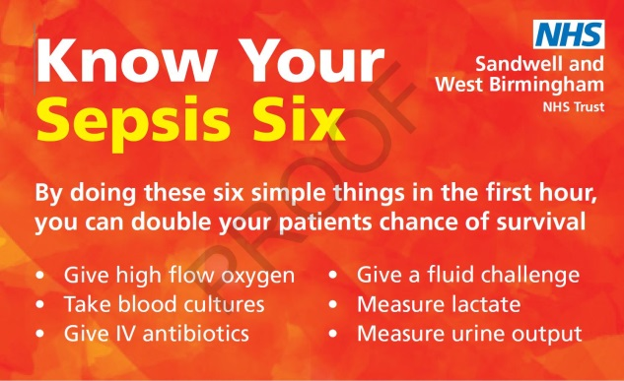
April 2022
Rapid improvement week for sepsis
From the 28 March we will be launching a rapid improvement week which focuses on the processes involved in screening and treatment of patients who present with sepsis.
The Rapid improvement week will also be supported by a Sepsis focussed display board competition and a bake off.
  Every year, patients at our Trust unfortunately lose their lives due to sepsis and it is clear that with systematic screening, early detection and timely treatment we could save many lives.
  In many cases sepsis is avoidable and treatable but this is predicated on early detection and timely treatment to give the patient the best chance of survival.
  The detection of sepsis is based on a well-established protocol using National Early Warning Scores (NEWS) where a score of 5 or more is an indication that a patient may be suffering from sepsis. A NEWS score of 5 or more is also trigger for clinical colleagues to begin using the sepsis action tool and to deliver the Sepsis 6 within one hour.
  Colleagues who are unsure of the sepsis screening processes are encouraged to speak to their ward matrons or contact the deteriorating patients and resus team on ext.5908

Slide 9
April 2022
My planned care patient platform
Patients on the waiting list for NHS care will be able to access support and check wait times on a new online platform.
The My Planned Care platform will allow patients and their carers to access information ahead of their planned appointment, operation or treatment.
In this first stage, around 5.5 million patients – of the six million on the total waiting list – will be able to search on the site to find the average waiting time at their local hospital for the specialist area they need treatment in.
Data from 137 NHS Trusts across England is now on the site, hosted by nhs.uk.
SWB data is already on the platform and work is in progress to ensure the correct information is being pulled through.
We plan to soon add information on staying healthy while people are waiting for their appointment.
Please be aware that patients may use the information on this site to understand where they are on waiting lists and may ask questions based on this information.
The SWB my planned care page is available here

Slide 10
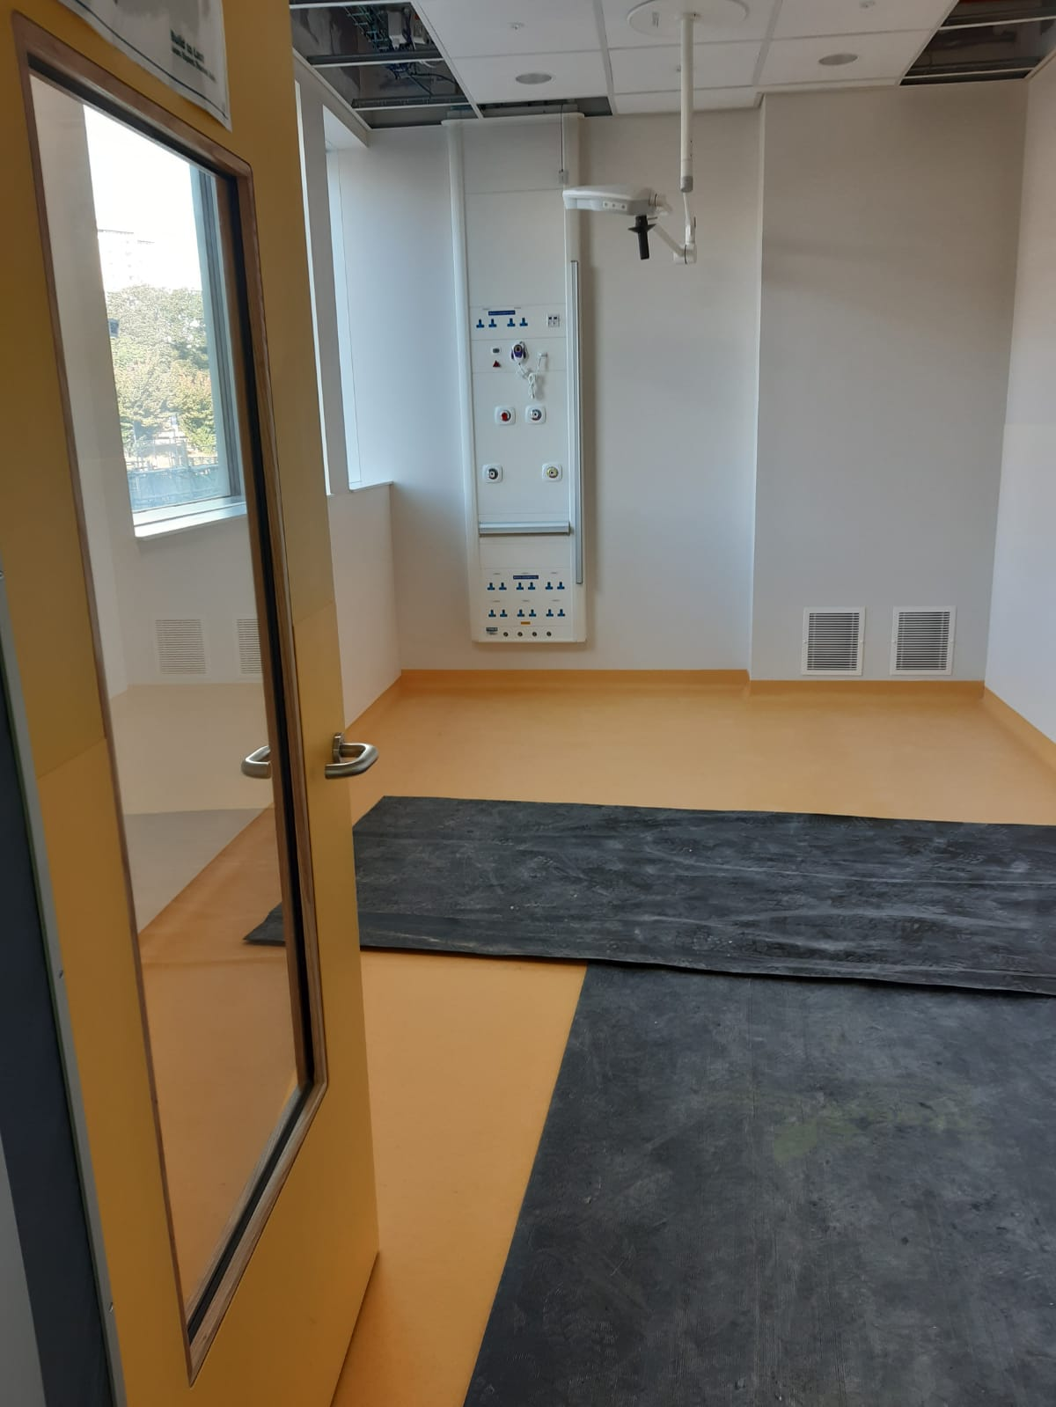
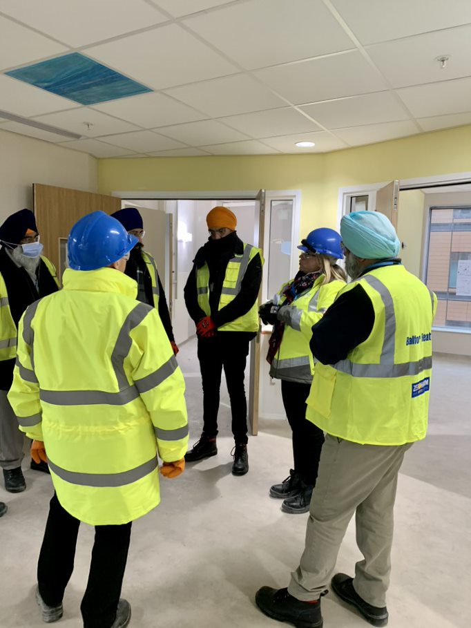
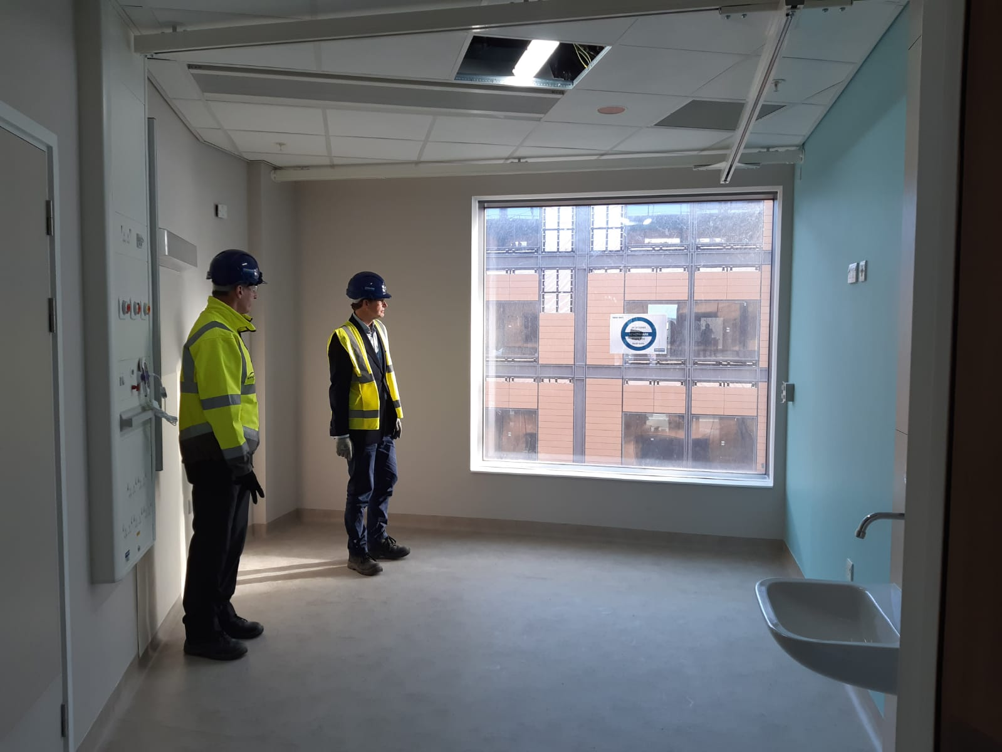
April 2022
Midland Met developments
In March the Trust Board reviewed the transformation pathways that have been developed. Some of these can be implemented before moving into the new building. Thank you to everyone who has worked hard to develop these new clinical pathways.
The Public Trust Board in April will receive more detailed information for approval that covers:
  •The acute care model and associated clinical pathways
  •The workforce plans
  •The financial requirements
The national new hospital programme team are working closely with Balfour Beatty to review the construction programme to enable us to commit to an opening date that we can have confidence in. Our priority remains to be ready for a move in May 2023. Everyone must focus their efforts on this important milestone.
The building is progressing well with many of the benchmarked rooms now ready to the standards required.

Slide 11
Population
To work seamlessly with our partners to improve lives
April 2022

Slide 12

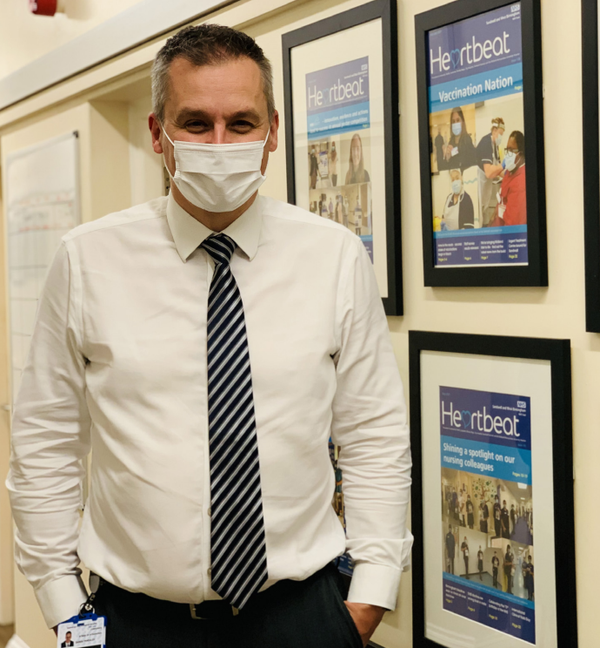
April 2022
New appointment: Chief Integration Officer
Daren Fradgley has been appointed to the substantive position of Chief Integration Officer following an external recruitment process. Daren joined the Trust on an interim basis in October 2021 from Walsall Healthcare NHS Trust.
Daren is responsibly for driving forwards our integration work across the Sandwell and West Birmingham places, leading the development of the place-based partnership in Sandwell, which is hosted by the Trust.
Daren is a practising paramedic and led the Walsall Together programme, a virtual organisation delivering integrated care across multiple partners.
He will formally take on the position from 1 April 2022.

Slide 13
April 2022
ICS update – clinical summit
Healthcare leaders from across the Black Country met face to face for the first time in two years at the Black Country Provider Collaborative clinical summit on 7 March.
It was focused on bringing together clinicians and staff from 15 different specialities to talk about and progress the work being undertaken around clinical transformation.
Currently 53 per cent of the Black Country live in the most deprived areas. The aim is to build on the work that has already been started and work as one system to ensure all our patients have equal access to high quality services. Partnerships, people and passion is at the heart of this.
Attendees also heard updates and plans from the nine clinical leads highlighting key service areas which would benefit from collaborative working to improve patient care.

Slide 14
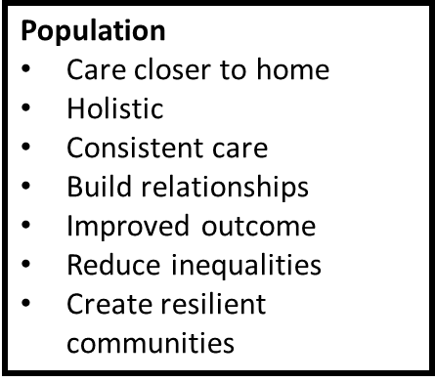
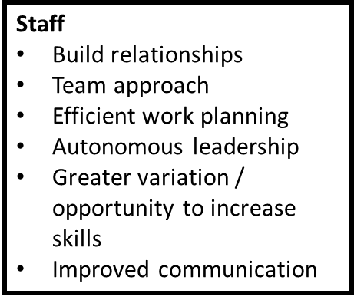
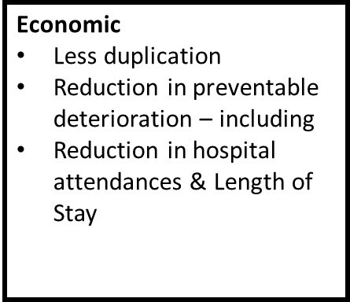
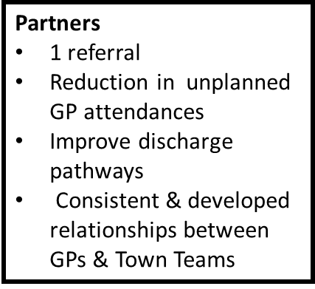
Sandwell Health & Care Partnership: Developing Integrated Primary Care (Town Teams)
What are Town Teams?
Each of the 6 towns will have a core multi-professional team (inclusive of community health, social care, mental health, public health, pharmacy, housing, social prescribers)
Data informed
Shared records
Proactive approach – utilisation of population health data to create a local ‘at risk’ register (the most vulnerable)
Holistic support
Reactive approach – single referral & trusted assessor
Creation of local health & wellbeing hubs with co-located teams
Why are they being developed?

Slide 15
People
To cultivate and sustain happy, productive and engaged staff
April 2022

Slide 16


April 2022
2minutes2 help shape our values
The best organisations have a clear, defined set of values – the guiding principles and beliefs that underpin the organisation and its employees.
Values should be firmly embedded into everything we do.
Our Trust has lived by our nine Care Promises for over a decade.
As we have developed our new strategy, with a focus on our People, our Patients and our Population, the time is right to consider a new set of values that will be the foundations of our Trust’s culture.
Our values will need to be accompanied by behaviours that we should all live up to in our daily working lives.
In order to build our own, new set of values, we are asking every colleague to tell
us how you feel about working here.
What instantly comes to mind when you think about our organisation?
What do we do really well? What could be better?
We want to hear everyone’s voice. Take two minutes to help us shape our
values – click here to find out more.

Slide 17
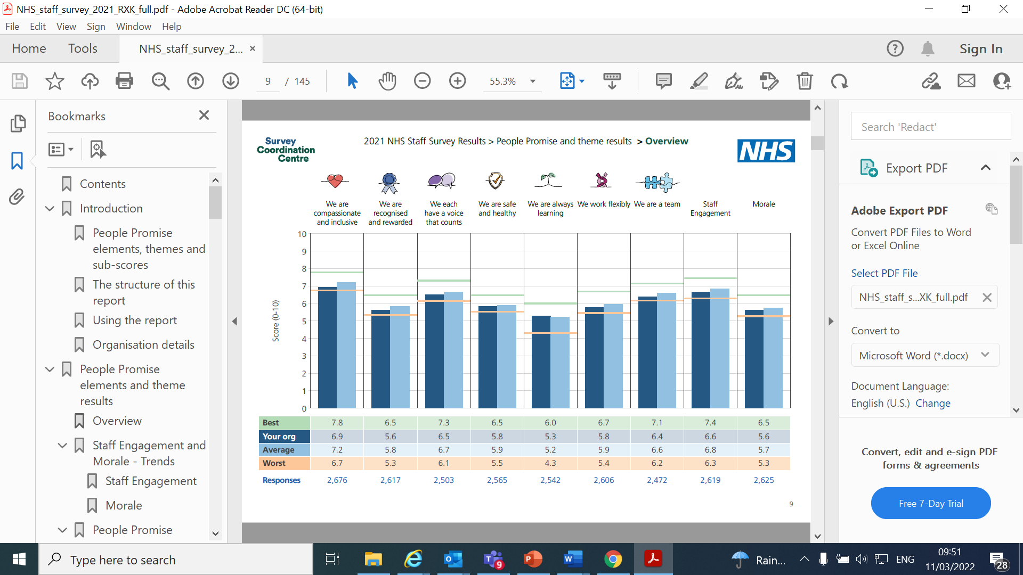
April 2022
Staff survey results 2021
The response - 39.3% (2,920)
For 2021 the theme results were changed to align with the national people plan promises.
Results have been shared with the groups and are also available to see on Connect.
Listening events are underway and groups are identifying top three actions to be submitted at the end of April. The Trust-wide plan will then be shared.

Slide 18
April 2022
Mandatory vaccination revoked
The regulations making COVID-19 vaccination a condition of deployment in health and social care were revoked on Tuesday 15 March. This decision followed a public consultation, where 90 per cent of responses supported the removal of the legal requirement for health and social care staff to be double vaccinated.
The regulations removed include:
  Regulations requiring COVID-19 vaccination to work in Care Quality Commission registered care homes, lifted from 15 March.
  Legal requirement for health and social care staff to be double jabbed from 1 April to be removed.
The requirements for vaccination as a condition of employment has been removed from all Trust job adverts.
The FAQs have been updated and are on Connect here. This includes advice on what to do if patients ask about the vaccination status of staff who are caring for them.
The Trust continues to strongly encourage anyone who is eligible to receive the vaccination. Vaccinations are key in helping to manage the impact of COVID-19, protecting the health and safety of our staff, patients and the wider community ensuring we can continue to provide safe health and care services at this challenging time.
It’s not too late to get vaccinated at one of our hubs. The vaccination hubs are still open daily at City and Tipton, no appointment necessary, just drop in.

Slide 19
April 2022
Cyber security is all of our responsibility
Cyber security is the responsibility of all colleagues, from ensuring you do not share your passwords with anyone, stay aware of unsolicited emails and follow information governance practices to protect data.
The NHS is one of the biggest direct and indirect targets for cyber criminals who are keen to get their hands on valuable patient data as well as disrupting our systems.
  Remember, not all cyber risks come from websites and links in emails, a significant proportion of cyber attacks are the result of social engineering, where someone simply convinces you to hand over your login details.
  If you feel you could do with brushing up on your cyber security skills, log in to the free cyber security training now on offer from the National Cyber Security Centre, on the link below:
  Top tips for staff - Overview (ncsc.gov.uk)
  Learn about:
  Defending yourself against phishing
  Creating strong passwords
  Securing your devices
  Reporting incidents

Slide 20
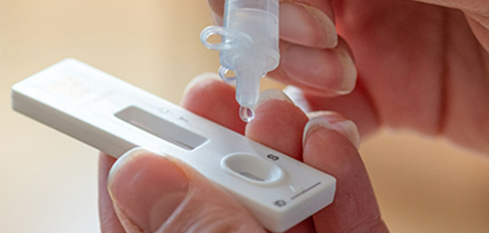
April 2022
Moving from LAMP to lateral flow
We have now moved away from LAMP testing to lateral flow testing.
Colleagues must complete two tests a week at home before arriving at work.
We all know how important testing is and as restrictions have eased, we must remember that as healthcare staff, there is still a chance that we will come in to contact with those suffering with COVID-19 and vulnerable patients – so it’s critically important that we continue to test and report.
Lateral flow testing kits can be ordered online with colleagues either having them delivered directly to their home address or alternatively collecting from community locations.
We are aware that lateral flow device ordering is challenging. Availability to order appears to fluctuate through the day. The Trust has a small supply that we are retaining for people who need to test daily in order to return to work following a positive test.
We are expecting a national gateway for health and social care staff to order lateral flow devices and will share the details of this as soon as it is available.
All completed lateral flow tests must be reported on the Trust Lateral Flow Test reporting form which can be found on Connect and the myConnect app. To submit results, colleagues will be required to login with their NHSmail email and password.
Any unused LAMP test bags and sample containers can be returned to the phlebotomy departments on each site.

Slide 21
April 2022
Declaring interests – new way now available
The Trust’s new way of declaring interests through ESR is now live.
Colleagues can follow the simple process as outlined in this presentation - Recording declarations of interest on the electronic staff record (ESR) system (Powerpoint)
As NHS staff, we need to declare any interests – including gifts, hospitality or sponsorship received from third parties – to ensure transparency on how public funds and assets are being used and accessed. This will bring the Trust in line with the NHS England Guidance https://www.england.nhs.uk/ourwork/coi/.
The Trust’s Associate Director of Corporate Governance / Company Secretary can also help provide advice on interpretation of the guidance; however decisions about what to declare or not are the responsibility of individuals.
Please don’t hesitate to contact the Dan Conway at swbh.declarations-admin@nhs.net if you have any questions.
Dan will be offering the following drop in session on Microsoft Teams, for a live demonstration of how to make your declarations on ESR and a Q&A session.
  Thursday 24 March from 3pm (session will last no longer than 30 minutes): Click here to join the meeting
Further info is on Connect.

Slide 22
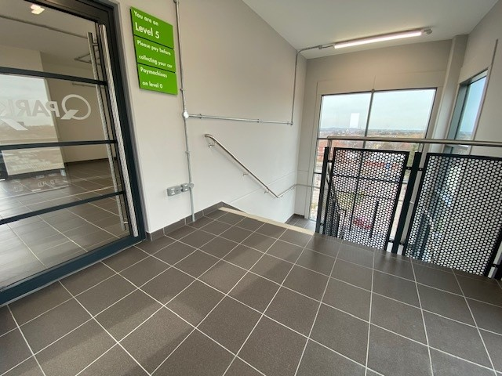
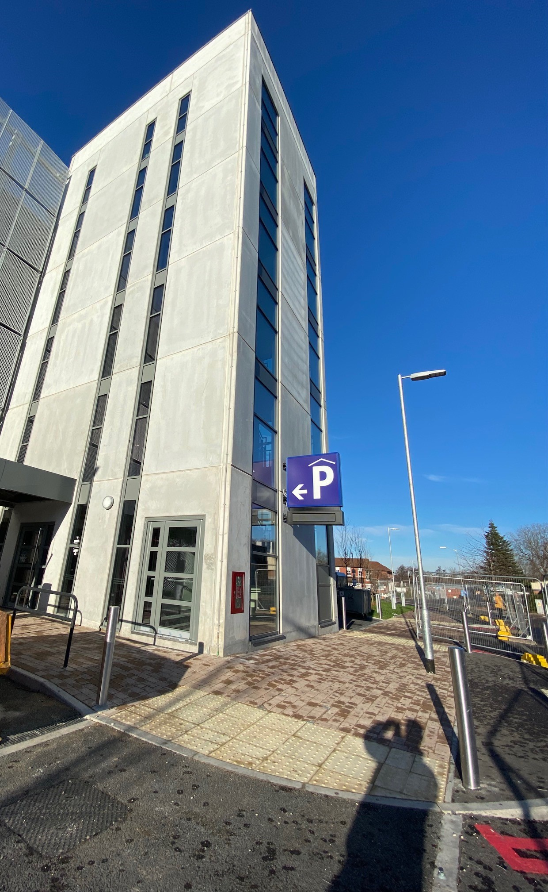
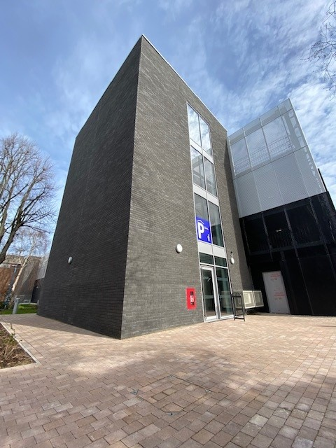
April 2022
New multi-storey car parks
The two new car parks at City and Sandwell will open on 1 April 2022.
You must apply for your pass and collect your pass before 31 March. Old car parking passes will no longer work after 31 March 2022.
The national agreement on free car parking for NHS staff ends on 31 March 2022. The Trust has agreed not to introduce car parking charges for staff at the present time. This will be in place for April – June and will then be reviewed.
For any queries about car parking please contact sandwell@q-park.com.
The Trust has also agreed to increase mileage rates for staff whilst awaiting a national agreement, Mileage rates will increase from 56p to 60p (up to 3500 miles) and from 20p to 22p (over 3500 miles).

Slide 23

April 2022
Support for colleagues affected by the conflict in Ukraine
Following the shocking events of the invasion of Ukraine by Russian forces, we would like to encourage anyone who is worried, anxious or experiencing problems to can contact the Trust’s confidential counselling service.
The counselling service is free to all SWB colleagues. Alternatively, specialised trauma focussed therapy is available to colleagues.
If you feel formal counselling support is not required at present but would like to talk to someone confidentially on an informal basis or for wellbeing support then please contact occupational health and wellbeing team for an appointment at our wellbeing hubs or via telephone.
To book an appointment, call occupational health on 0121 507 3306 and choose option 1. There are also further additional resources for you to choose from which can be found on Connect.

Slide 24

April 2022
Helping those directly affected by the war
Many of you will want to do more to help the people directly affected by the war. And some have particularly asked about practical assistance such as medical supplies or equipment.
The UK has already provided over 650,000 medicines and medical items such as wound packs and intensive care equipment, deployed a humanitarian team to the region, and is exploring further options to stand with our Ukrainian friends.
In addition to medical aid being delivered to Ukraine, the NHS are also working with government to plan for how we can help by receiving people affected by the conflict, whether that is those who have had their treatment interrupted, have been injured or those who have become refugees.
Rather than trying to contact Ukrainian or neighbouring authorities directly with offers of support, NHS organisations are asked to direct their contributions to England.incident14@nhs.net.
The government has published further information on how the public can help with support for Ukraine, which includes details of the Disasters Emergency Committee, a coalition of 15 leading UK charities, which has launched its collective appeal to provide emergency aid and rapid relief to civilians suffering during the conflict.
SWB also recently supported the collection of clothing and essentials co-ordinated by the cancer services team working with local charity Bearded Broz who arranged for items to be sent to Poland and neighbouring countries. Thank you for your contributions.

Slide 25
TeamTalk Feedback Topic – supporting your teams
with wellbeing
April 2022
Thank you sending in your feedback. Feedback received this month is summarised below:
Regularly take their statutory breaks
Teams should encourage colleagues to take their breaks and work together to release colleagues from their duties
Colleagues need space to take their break away from patient and service areas
Take their annual leave allowance
Colleagues should be enabled to discuss their leave requirements so that opportunities for leave can be fairly shared across the team, not a race to book
Develop duty templates to track leave preferences to support those with childcare / care commitments
Have time to access some of the wellbeing support available e.g. the wellbeing hubs?
Colleagues should allocate and book time for wellbeing, but some feel the travel to the hubs and added workload from downtime can add to stress levels
Colleagues keen to access services, but can services come to them?
Have time to refresh and reflect as a team.
Encourage teams to socialise and have downtime from their duties, the teambuilding and atmosphere it generates boosts morale
Teambuilding opportunities we had over the summer were well received, will this be regular?

Slide 26

April 2022
TeamTalk feedback topic: Supporting end of life patients
The challenge:
On national audits we perform below average in our end of life care delivery. A trust-wide quality improvement project has been underway for over a year to engage us all in developing quality resources to improve the consistency and standard of care at the end of life.
This was the Feb QIHD focus – thanks for taking part!
It is all about early recognition, timely conversations, holistic assessments, documenting and sharing the bespoke goals and priorities of each patient.
The resources: Reports / Education / Tools
Reports: A new dashboard of metrics for the trust and each ward area to allow self assessment of quality in end of life care delivery, to guide tailored quality improvement activity in each ward area - accessed via Connect.
Education: Range of new mandatory training modules soon to be released on ESR, alongside in-person training. These modules are already available via e-ELCA.
Tools: Supportive and Palliative Care Indicators Tool (SPICT) now available through Unity
    How to find it: On Unity: Adhoc > Assessments > SPICT (bottom on list of assessments)
    Validated tool to identify those who may need palliative care approach
    If patient identified as potentially in last 12 months of life, supportive care plan can be commenced
The opportunity – this month please discuss within your teams:
How can you develop end of life care in your department as an every day commitment?
How will you utilise the above listed resources to improve end of life care in your department?
Send your responses by 20 April to subtan.mahmood@nhs.net

Slide 27
April 2022
Your questions answered

