Slide 1
Recording declarations of interest on the electronic staff record (ESR) system

Slide 2
Conflicts of interest: do I need to make a declaration?
Every member of staff at SWBH has a responsibility to make a declaration of interest where it is needed. Each case is different, but there are several common situations which could lead to a conflict of interest, including:
Gifts – even something which might seem small, such as a patient giving you a box of chocolates
Hospitality – things like meals, refreshments, travel or accommodation when you attend meetings or other events
Outside employment
Donations
Sponsored events, research or posts
Clinical private practice.
Having a conflict of interest does not mean you have done something wrong but failing to manage it properly is against the rules. We are now using the ESR system to help simplify the process of making a declaration or ‘nil return’.

Slide 3
Isn’t this just for managers?
No!
Any member of staff can make a declaration so please click through this guide which will walk you through what to do.

Slide 4
I have a declaration to make – what should I do first?
Speak to your manager.
Before you complete a declaration of interest please make sure you have spoken to your manager first and agreed how any conflicts you are about to declare will be managed
Once you have done that, the following pages take you through how you can complete a declaration simply on the ESR system

Slide 5
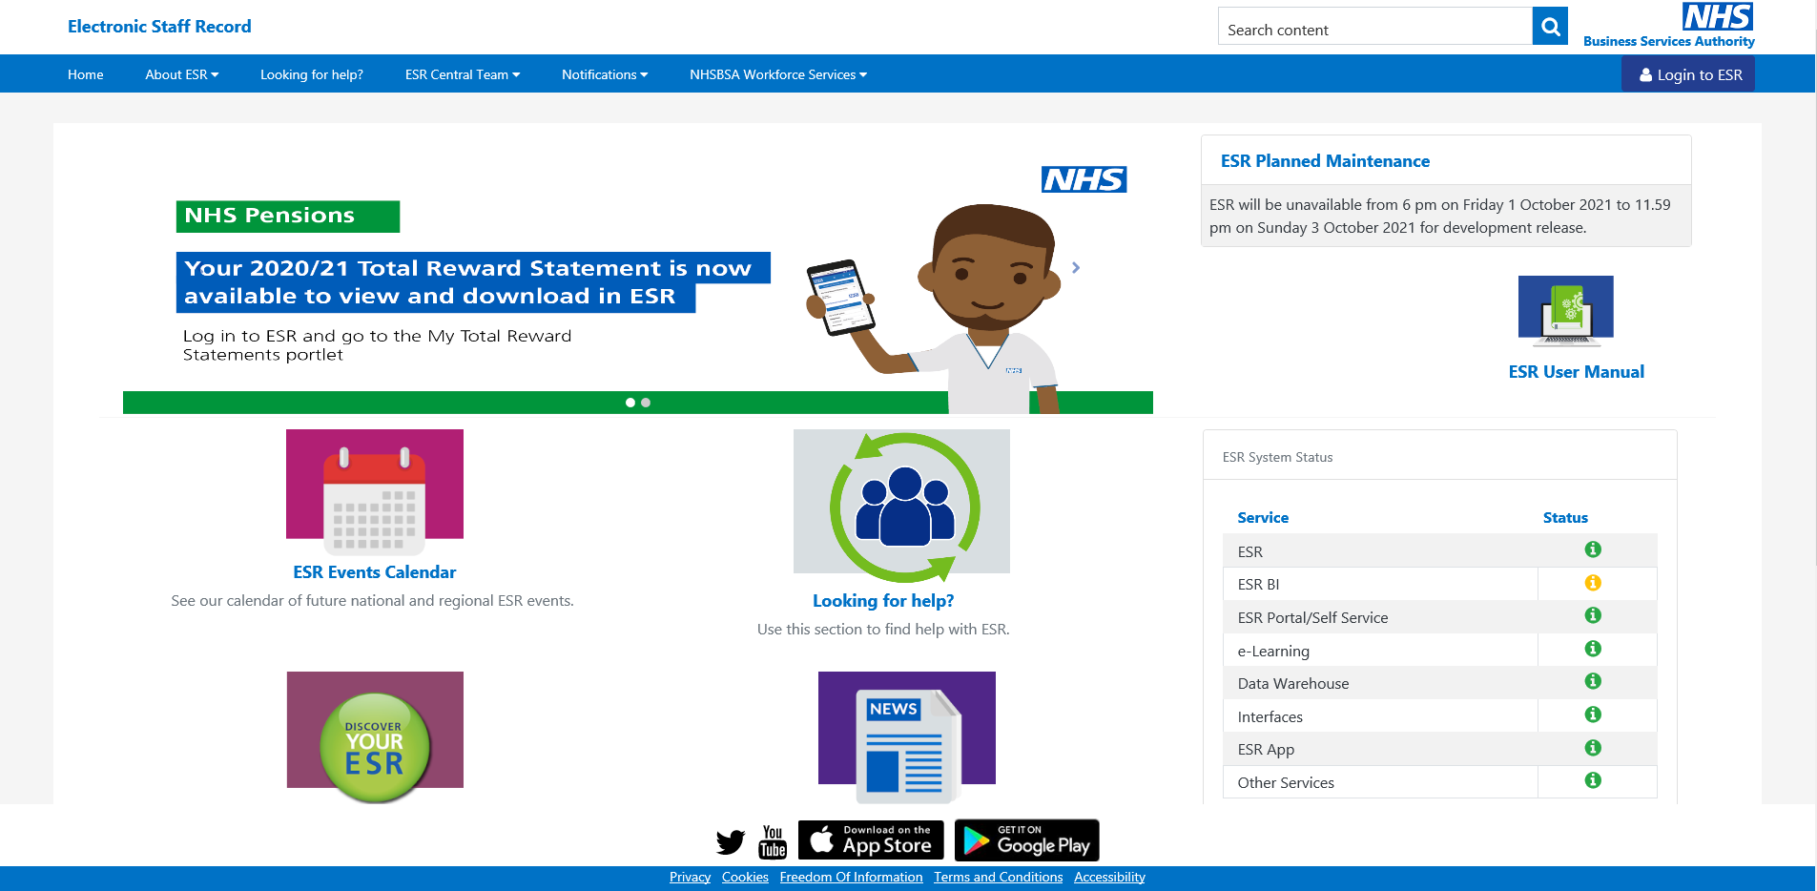
This is the ESR Hub

Slide 6
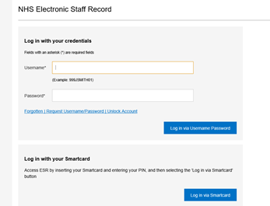
You can log onto ESR via the website https://my.esr.nhs.uk/ or the app (which you can download free).
Click on the ‘Login to ESR button
Enter your username and password.
If you do not have one or forget your password press the forgot username/ password which is just underneath the password box in blue writing

Slide 7
Once logged in, on the left hand side click on ‘My personal information’ – it will expand a menu where you can find an option called ‘Conflict of Interest Declaration’.

Slide 8
Conflict of Interest Recording
Conflict of Interest Recording
Under conflict of interest declarations you can add a declaration and see any previous declarations you have made
Click on add declaration even if you are returning a ‘nil response’

Slide 9
Conflict of Interest Recording
If you have no interest to declare tick the box and click apply

Slide 10
Conflict of Interest Recording
It will look like this…

Slide 11
Conflict of Interest Recording
If you have an interest to declare – click the add declaration button.

Slide 12
Conflict of Interest Recording
Choose a category from the dropdown menu…

Slide 13
Conflict of Interest Recording
Choose a situation from the dropdown menu…

Slide 14
Conflict of Interest Recording
Add a description and dates in the boxes provided…
Type your manager’s name in the comments box, having already agreed with them how any conflicts you are about to declare will be managed
Tick the box to confirm you give your consent

Slide 15
Conflict of Interest Recording
It will look like this…

Slide 16
Conflict of Interest Recording
If you have a question about whether you should declare something contact Dan Conway, Associate Director of Corporate Governance at: swbh.declarations-admin@nhs.net

