Slide 1
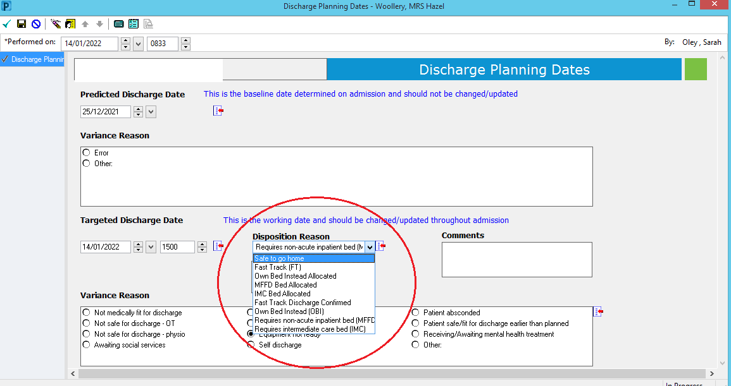
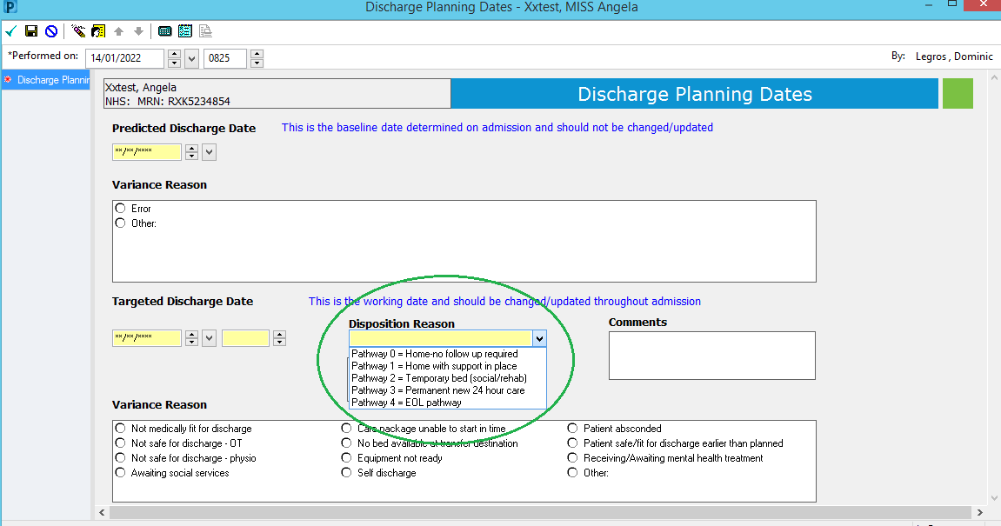
Why not home? Why not today?
Unity Change –Tues 25th January ‘22
To bring our systems in line with national D2A language and to enable better visibility and co-ordination of patient discharge pathways, the following Unity change will be implemented from 25.01.22.
This relates to the ‘Disposition reason’ inputted when setting/changing a TDD:
What you see now:
What you will see from
25th January:
These options align with
discharge pathways 0-4
and should be selected
and updated in line with
any TDD updates
Pathway 0 (50% of people)
Simple discharge, no formal input from health or social care needed once home
Pathway 1 (45% of people)
Support to recover at home; able to return home with support from health and/or social care
Pathway 2 (4% of people)
Rehabilitation or short-term care in a 24-hour bed-based setting
Pathway 3 (1% of people)
require ongoing 24-hour nursing care, often in a bedded setting. Long-term care is likely to be required for these individuals.
Pathway 4
All End of Life pathways (either home or 24 hr care)
Reminders:
This is a postcode blind process and is the same for every patient regardless of their home address/GP
TDDs should be reviewed & updated at each board round
Please use the Pathway drop-down accurately (this directly links to the Integrated Discharge Hub activity)
Continue to highlight patients as ‘Clinically Fit for Discharge’ on Unity when they are medically optimised
For queries please contact the Integrated Discharge Hub, 8am-8pm, 7 days per week on 07815 647936

